Slide 1
International Invoicing
Brussels F2F 2019-10-16

Slide 2
Georg Birgisson
Project editor

Slide 3
Project mandate
Outcome
An international invoicing model which design follows the proposals set forth in the PEPPOL International Invoicing Pre study report.
The OpenPEPPOL International Invoicing Model will enable PA’s in different parts of the world to implement eInvoicing through the PEPPOL network with support to their national requirements while maintaining the possibility to exchange invoices internationally.
Project leader, Paul Simmons, PEPPOL POAC lead.
Project editor, Georg Birgisson, PEPPOL OO.

Slide 4
Current Post Award situation for Invoice
PEPPOL BIS Billing 3.0, mandatory since 2019-04-18.
Compliant CIUS (restriction) of the EN 16931.
Implementation provides compliance eInvoicing directive 2014/55.
BIS includes seller country rules (must be relevant for all sellers in a country).
Used by NO, SE, DK, IT.
EN 16931 is designed to support EU directives, mainly VAT directive 2006/112
PEPPOL BIS Billing 3.0 can not be mandated to non-EU/EEA members states
Singapore, Australia and New Zealand extensions.
Suppress some tax rules of EN 16931.
Apply some of Tax calculation rules redefined as GST.
Additional legal requirements.
Mandatory principle temporarily on hold.

Slide 5
PEPPOL International Invoicing Pre-Study
Recognizing challenges to the current mandatory BIS and the application of the mandatory principle.
Mandatory principle
PEPPOL Communities define PEPPOL BIS to promote global interoperability. ... Receivers with a registered receive capability for a business function for which a PEPPOL BIS is available shall have receive capabilities for the PEPPOL BIS registered in an SMP, as a minimum.
Applied through a single mandatory BIS specification, PEPPOL BIS Billing 3.0
Main work
Identify gaps in requirements
Assess feasibility of international invoicing and propose solutions.

Slide 6
The European Invoice Standard EN 16931
EN16931 standardization request
Implements eInvoicing directive 2014/55.
Scope is public procurement.
Supports B2B
Leveraging investment.
Legal requirements
Supports EU directives.
Mainly VAT directive 2006/112
Provides for EU national requirements
Business requirements
Core supporting “common” requirements.

Slide 7
Invoice content drivers
Business domain e.g. country A
Business domain e.g. country B
B1
S2
Business requirements
Legal requirements
Business requirements
Legal requirements
S1
Business requirements
B2
Legal requirements

Slide 8
EN 16931 and the World
EN 16931
Legal requirements
EU directives do not apply outside of EU.
Business requirements
SG has adopted as-is.
AUNZ adopts mostly as-is.
N-America BPC estimates about 90% applies.
PEPPOL BIS Billing
Non-EU
Legal EU
Business
Legal
non-EU

Slide 9
Shared: Fully defined
Common for all domains.
Minimum rules
Sufficient for basic automations
Reading into ERP system
Booking into accounts
Order to invoice matching
Key content
Trading parties
Total amounts.
Items and prices.
References

Slide 10
Generalize
Generalizing content aims to address all requirements
PEPPOL BIS Billing
EN 16931
Legal EU
Business
Legal
non-EU

Slide 11
Aligned: Generalized → Specialized
Generalized
Understood in general terms by all domains
No rules
Not optimized for automation.
Can be specialized for domain specific automation and compliance.
Key content.
Tax information.

Slide 12
Other requirements
PEPPOL BIS Billing
EN 16931
Legal EU
Business
Legal
non-EU

Slide 13
Distinct content
Not commonly understood in all domains.
Syntax semantics apply.
Type of content.
Content that is distinct for different domains.
country
sector

Slide 15
PEPPOL International Invoicing Model
Aligned
Shared
Distinct

Slide 16
Interoperability
The fully defined part MUST be shared by all.
non EU AU, NZ, SG N Ame
Compliant specialization
Int’l model
Compliant specialization
International
interoperability
Compliant specialization
Generalization
Implemented as one common BIS using conditional rules or in separate BIS specifications
CIUS
BIS Billing 3.0
EN 16931

Slide 17
Mandatory invoice
Registration of receiving capabilities

Slide 18
One or many mandatory BIS?
Depends on factors like
How the PEPPOL mandatory principle is applied.
All receivers must be able to receive the same mandatory BIS.
PEPPOL BIS Billing 3.0 can’t be mandated for all due to different legislation.
Should the International model be a BIS and made mandatory to all.
Each receive must receive a BIS that complies with the international model.
Then how does the sender know it is compliant and what
How receiving capabilities are registered and then looked up.
Before sending (to know what can be received)
When sending.
Allowing it through network.
Validating then content.
Should the objectives of the Mandatory Principle be achieved through a single BIS or through the shared component within BIS.

Slide 19
One vs many
One
Can the rules be implemented as conditional without interfering with each other? Specially if a domain uses distinct content.
How to enforce rules for different regions in the same country, there is a challenge to finding a correct trigger for the rules.
IF one domain needs to update their rules then everyone is affected. At least they need to roll out a new rules set and verify if it interferes with their needs.
Many
Requires modification to the methods for registering receiving capabilities, discovering them and matching them.

Slide 20
Hierarchical layering
Compliance relation
PEPPOL international invoice model
EN 16931
PEPPOL BIS Billing 3.0
Spanish facturae
TransTasman
International model
Invoice domain specifications
Implementation specific
Singapore

Slide 21
Receiving restricted versions
It can be assumed that a receiver of a specification will accept and process any document that is a based on a restricted version of that specification.
this is in fact the underlying principle behind EN 16931 accepting CIUS as compliant implementation.
Using wildcard for registering receiving capacities.
urn:cen.eu:en16931#compliant#urn:fdc:peppol.eu:2017:poacc:billing:3.0#compliant:*

Slide 22
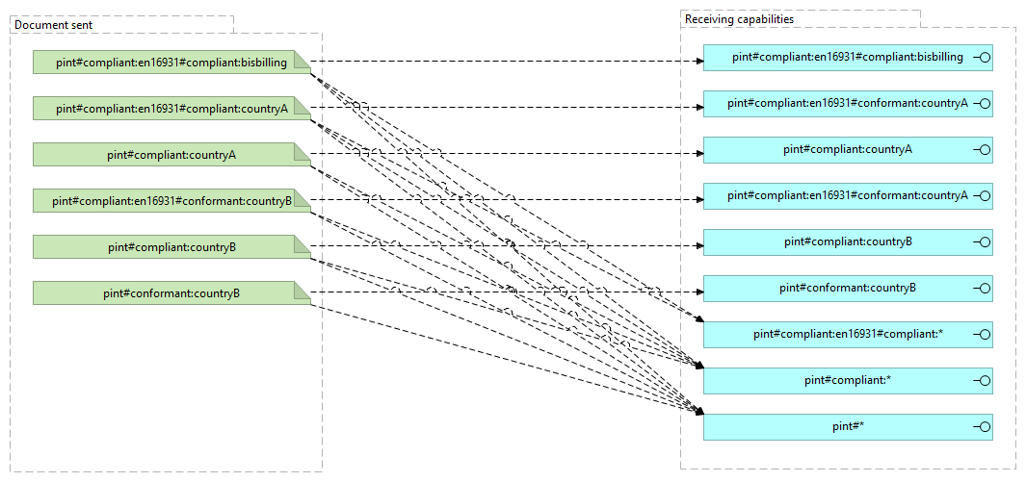

Slide 23
Not all BIS are equal
Depending on conditions different receivers may prefer or require different restricted specifications.
European receivers prefer EN16931 compliant invoices.
European receivers only accept non EN16931 from non-EU senders.
Same country trading parties prefer their country restricted invoices.
A receiver may accept common BIS but prefer a particular restriction.
Should the network provide for added information and control of what is exchanged?
Party legal domain?
Preferred BIS.

Slide 24
Project planning

Slide 25
Participation
Open to all PEPPOL members
Contributing
Observing
Open to non-PEPPOL parties
Contribution that expands the international value of the project.

Slide 26
Project timeline
Call for participation
2019-10-09
Kick-off meeting
2019-10-22
Draft model
2019-12-31
Beta version
2020-04-30
Puplication
2020-09-30

Slide 27
Development phases
Drafting phase
Requirements known.
Beta phase
Participating PEPPOL members apply the draft to their business environment
Review phase
Circulate beta version with examples of how it can be implemented in different countries.
PEPPOL BIS Billing 3.0
Singapore extension.
AUNZ extension
BPC report.
Drafting wo further collection of requirements
Pre-study
Draft will then be modified as needed resulting in a beta version.
Invite wider input.
Encourage trials.
Approval of the international model
Publication.

