Slide 1
Peppol International Invoice
07 — Meeting slides 2019-12-03

Slide 2
Constraints
Mandatory principle
The mandatory principle is stated in clause 5 of the PEPPOL compliance policy as:
“PEPPOL Communities define PEPPOL BIS to promote global interoperability. Nevertheless, new document types and customizations may be defined and supported if they are defined and registered according to PEPPOL registration procedures. Receivers with a registered receive capability for a business function for which a PEPPOL BIS is available shall have receive capabilities for the PEPPOL BIS registered in an SMP, as a minimum.”
EU directive on EN 16931
Article 7, Receipt and processing of electronic invoices — Member States shall ensure that contracting authorities and contracting entities receive and process electronic invoices which comply with the European standard on electronic invoicing ...
EN 16931 — An invoice document instance is compliant to the core invoice model if it respects all rules defined for the core invoice model, which may include the specification contained in a conformant CIUS.
Limit localised constraints on eInvoicing.

Slide 3
Hierarchical layering
Compliant relation
PEPPOL international invoice model
EN 16931
PEPPOL BIS Billing 3.0
becomes EU domain speci
Spanish facturae
TransTasman
International model
Invoice domain specifications
Implementation specific
Singapore

Slide 4
PEPPOL international invoice model
Code: A, B, C and D are OK
BIS Billing 3.0
EU domain specific
TransTasman
Singapore
EN 16931
AUNZ law
SG law
EU-2-EU
- Only code A, B and C OK
If invoice received from NZ
then D not rejected.

Slide 5
Receiving restricted versions
It can be assumed that a receiver of a specification will accept and process any document that is a based on a restricted version of that specification.
this is in fact the underlying principle behind EN 16931 accepting CIUS as compliant implementation.
Using wildcard for registering receiving capacities.
urn:cen.eu:en16931#compliant#urn:fdc:peppol.eu:2017:poacc:billing:3.0#compliant:*
pint#compliant#AUNZ
pint#compliant#EUBISBilling3.0
pint#compliant#SG
pint#complinat#*

Slide 6
AUNZ
sender
pint#compliant#AUNZ
NO receiver
pint#complinat#*
SG sender
pint#compliant#SG
Receiving capability
pint#compliant#EUBIS3.0#compliant#BEextraRule
pint#compliant#EUBIS3.0
pint#complinat#*
BE sender
pint#compliant#EUBIS3.0

Slide 7
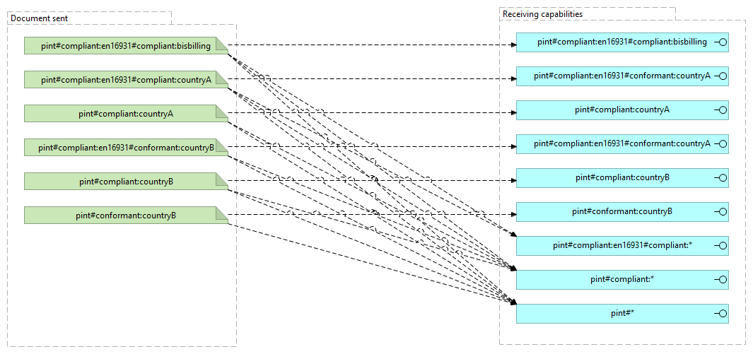

Slide 8
Not all BIS are equal
Depending on conditions different receivers may prefer or require different restricted specifications.
European receivers prefer EN16931 compliant invoices.
European receivers only accept non EN16931 from non-EU senders.
Same country trading parties prefer their country restricted invoices.
A receiver may accept common BIS but prefer a particular restriction.
Should the network provide for added information and control of what is exchanged?
Party legal domain?
Preferred BIS.

Slide 9
Conclusion of meeting

