Slide 1
Peppol International Invoice
06 — Meeting slides 2019-11-26

Slide 2
Code lists
Generic codes and used in full
ISO 3166-1 — Country Codes, shared
ISO 4217 — Currency codes, shared
UN/ECE Recommendation N°20 and UN/ECE Recommendation N°21 — Unit codes, shared
Identification
ISO/IEC 6523 — Identifier scheme code (ICD), shared
(OPI organization part identifier)
CEF EAS — Electronic address scheme identifier, shared as in Peppol.
Concatination of ICD values, 3155 (uri, smpt), temporary Peppol.
Peppol uses a subset.
UNTDID 7143 — Item type identification code, shared
Costs
UNTDID 5189 — Allowance codes, shared
UNTDID 7161 — Charge codes, shared
Qualifiers
UNTDID 1001 — Document type, use Peppol approach but review the restriction that is applied.
UNTDID 1153 — Reference code qualifier, shared
UNTDID 2005/ UNTDID 2475 — Event time code, shared
UNTDID 4451 — Text subject qualifier, not used in int‘l model.
Mime type codes — Mime codes, shared as restriced in EN

Slide 3
Tax related
Tax type code, 5153, shared as subset.
Tax Category code, UNTDID 5305 not a shared code list.
CEF VATEX — VAT exemption reason code, not a shared code list.
Payment
UNTDID 4461 — Payment means, shared.

Slide 4
Topics to discuss for draft
Dividing of business terms into shared and aligned.
Rules that apply to the shared content.
Codes that apply to the shared content.
Additional business terms.
Generally used but not in the EN.
Distinct.
Interoperability in the network
SMP lookup.
Mandatory principle.
Preferences.

Slide 5
Hierarchical layering
Compliant relation
PEPPOL international invoice model
EN 16931
PEPPOL BIS Billing 3.0
Spanish facturae
TransTasman
International model
Invoice domain specifications
Implementation specific
Singapore

Slide 6
Receiving restricted versions
It can be assumed that a receiver of a specification will accept and process any document that is a based on a restricted version of that specification.
this is in fact the underlying principle behind EN 16931 accepting CIUS as compliant implementation.
Using wildcard for registering receiving capacities.
urn:cen.eu:en16931#compliant#urn:fdc:peppol.eu:2017:poacc:billing:3.0#compliant:*

Slide 7
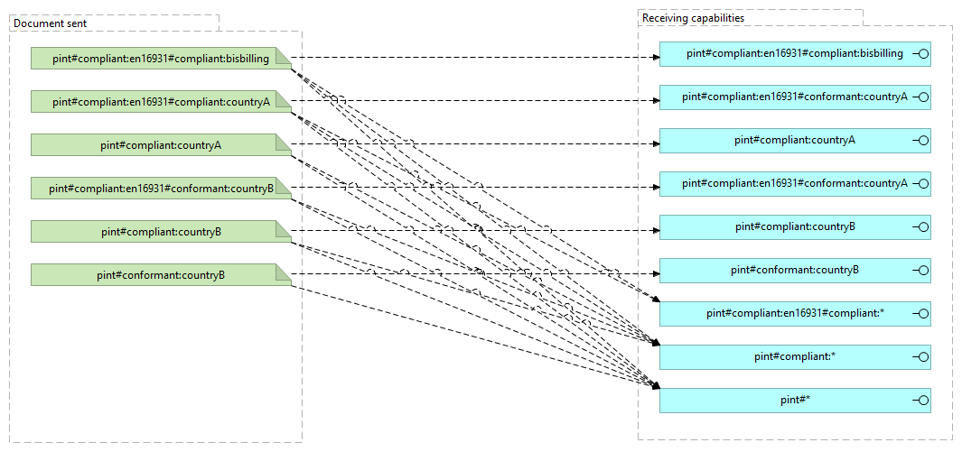

Slide 8
Not all BIS are equal
Depending on conditions different receivers may prefer or require different restricted specifications.
European receivers prefer EN16931 compliant invoices.
European receivers only accept non EN16931 from non-EU senders.
Same country trading parties prefer their country restricted invoices.
A receiver may accept common BIS but prefer a particular restriction.
Should the network provide for added information and control of what is exchanged?
Party legal domain?
Preferred BIS.

