Slide 1
OpenPEPPOL eDelivery WG
Kick-off
05.07.2019
Klaus Vilstrup Pedersen
OpenPEPPOL eDelivery Community leader
Note: this session will be recorded

Slide 2
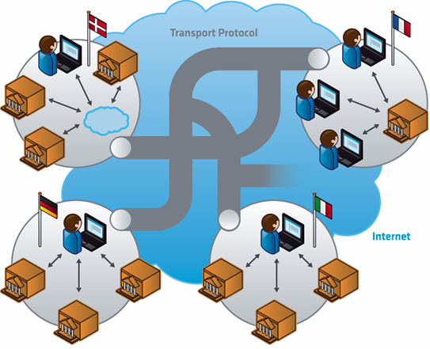
Peppol eDelivery
Agenda:
Welcome
meetings, etc.)
Issues and Plans for each WG (AS4, Enhanced Security, SML/SMP)
Administrative issues (organization, collaboration area, Next steps
SML plans (the SML WG has some issues that has to be resolved during July- August)
Notes:
OpenPEPPOL Mission
Encourage European governments and their suppliers to continue implementing eProcurement using the PEPPOL specifications and promoting best practices
Promote and support the development of innovative PEPPOL-based ICT products and services supporting public procurement processes, promoting their use also in the B2B context to harmonise processes across the private and public sectors, simplifying eProcurement adoption for SMEs
Ensure that the PEPPOL network continues to grow in an open, accessible and compliant manner, supporting interoperability for European public services and helping Europe move towards a Digital Single Market

Slide 3
AS4 WG
OpenPEPPOL is making the transfer of PEPPOL eDelivery from AS2 to AS4 in the period of 1.8.2019 to 1.2.2020 and it is foreseen that added support and issue handling will be needed.
Also a long term “product” strategy for AS4 needs to be established.
To use SBDH or not to use SBDH? (Rick)

Slide 4
AS4 WG plan
WG leader?
Finalization of AS4 transition 1.2.2020
OpenPEPPOL AS4 spec issue handling by mail until:
First meeting in week 34

Slide 5
Enhanced Security WG
Several PA’s and organizations has informally asked for enhanced security for secrecy, integrity, authenticity and non-repudiation (traceability).
Architectural work needs to be established for development and integration into the eDelivery architecture.
Corner 1 to Corner 4 security on secrecy, integrity, authenticity and non-repudiation (traceability)
Norway has implemented C1 to C4 security for ISO 20022 payment and eGovernment solutions
Australia and New Zealand requesting this for (certain kind of) eInvoices.

Slide 6
Enhanced Security WG plan
WG leader?
No requested deadlines
A plan has to be established with deadline accommodating stakeholders
Identify requirements
Identify needs
Use juli/august for collecting input to the WG (all)
First meeting in week 34

Slide 7
SML/SMP WG
Transfer og EC CEF ownership to OpenPEPPOL ownership
Requirement gathering
Mulitiple SMLs?
Move from PEPPOL SMP spec to OASIS BDXL spec?
Develop and maintain SML
Governace structure?
SMP
Evaluation of OASIS SMP 2.0?
PEPPOL Directory
Include in the WG? Now? (Rick)

Slide 8
SML/SMP WG plan
WG leader: Klaus Vilstrup Pedersen (for now!)
Plan see later
Collect and consolidate requirements
First meetings in week 34 (SML requirement gathering)
Workshop (net) with EC CEF, when is it feasible?

Slide 9
Cross WG issues
There is issues where many WGs needs to be involved (Rick)
Using SMP as host of public certificates
ASIC, SBDH, AS4, Security
Many participants in many WGs
Philip and Klaus will monitor where multiple WG coordination is needed
Transparent – all has access to all WGs

Slide 10
Other
Corner 5? i.e. send to more than 1 receiver.
Singapore to start some work to create a pilot
Australia has requirements
Norway in process of creating data-lakes of eInvoices
Overall architecture, building blocks, interrelationships, principles and other exchange patterns.

Slide 11
Information items
Next Community F2F meetings scheduled and confirmed to be:
Time: 15-16 October 2019
Place: Brussels, Belgium
Communications and sharing
Mail: A maillist will be established
Netmeetings: GoTo meeting: https://global.gotomeeting.com/join/831938205
Confluence: https://openpeppol.atlassian.net/wiki/spaces/EDNCC/pages/452460545/Work+groups+teams+and+task+forces

Slide 12
More information
E-mail: info@peppol.eu
Web address: www.peppol.eu

