Slide 1
Peppol Service Provider Community kick-off meeting
Ahti Allikas 18.06.2019

Slide 2
Brief facts
Ahti Allikas
Solution owner, Partners and Networks
OpusCapita Solutions OY
ahti.allikas@opuscapita.com, +3725276676
Member of Peppol Post-Award CMB
Member of Peppol Management Committee
Leader of Peppol Service Provider Community
Member of EESPA Executive Committee
Member of EMSFEI
Member of US/BPC eInvoice Workgroup
Estonian representative in TC434

Slide 3
Agenda
Role call
https://drive.google.com/open?id=1xNbjLQ8lQIqLfLyGshfsgiYJmwqfDE-nOV_hEZC74rA
Way of working
New Peppol agreement structure and its affect to the service providers (Jostein Fromyr)

Slide 4
Fill the Excel
Don’t filter, Don’t resort, just search for your company/name
Participation Yes/No
Comments - add in case you would like to change, add something
Active in No of countries - in how many countries you are active as SP
Expectations - Free text comment whatever you would like to have…
https://drive.google.com/open?id=1xNbjLQ8lQIqLfLyGshfsgiYJmwqfDE-nOV_hEZC74rA

Slide 5
Way of working
2-3 times in a quarter online meeting
F2F community meetings (twice a year)
Open a workgroup on a need basis

Slide 8
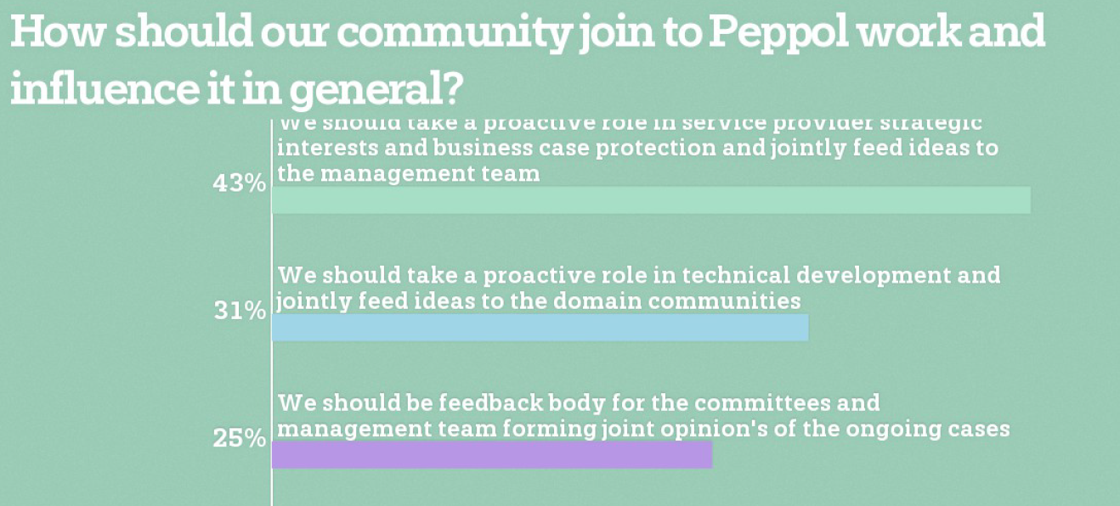

Slide 9
Time for new agreement structure

