Slide 1
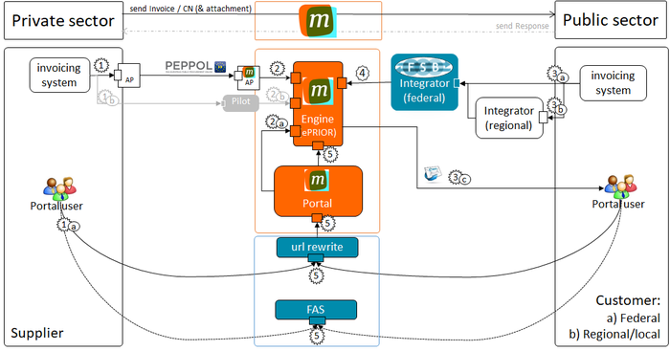

Slide 2
Scope of this document

Slide 3
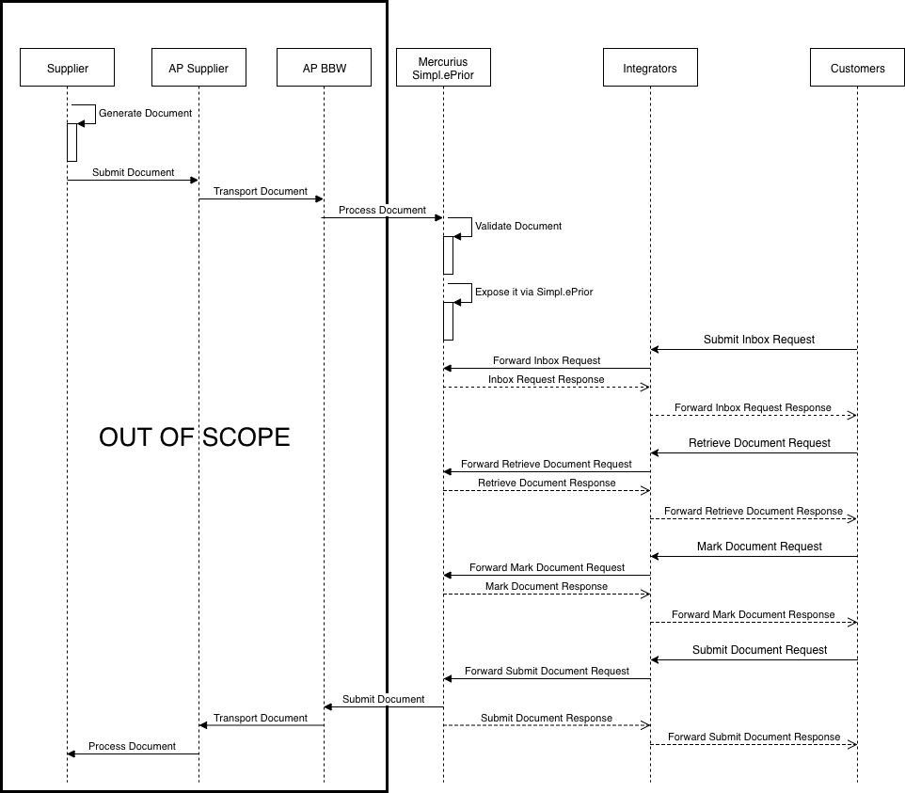

Slide 4
Outbound flow

Slide 5
Inbound flow

