Slide 1
Critical Infrastructure WG
Meeting | 15.04.2024

Slide 2
Agenda
Recap
Review of Conceptual Architecture options for federated SML (Phase 1 - 2024 Q2)
Inputs and discussion

Slide 3
Recap – Session 03/04/24
1. Joze Rihtarsic from EC shared current Peppol SML setup managed by EC
Hosting 1Mil Peppol Participants, 2Mil DNS records
Server restarts takes 20 min (loading DNS files into RAM takes time, 1.6GB RAM requirement)
All DNS under edelivery.tech.ec.europa.eu (was meant for POC, Demos - NOT build for big production deployment, DNS zone file has grown very big).
Jose also presented two possible options derived from US DBNA study
Option 1 - Multiple regional SML with its own top domain, could be per jurisdiction
* fallback to internal SML with a international domain
* dynamic discovery needs to update to use a fallback logic
Option 2 - Multiple regional SML with its own top domain, likely one per jurisdiction
Dynamic discover client needs to handle fall backs between all SMLs
2. Siraj outlines Group B framework for considerations and next steps
Key considerations framework (Technical, Business, Change impact)
Next 3 meetings to review proposed architectures

Slide 4
[Recap] Decision - Making Frame
Three Dimensions of Consideration
Technical – Reliability, Scalability, Availability & Serviceability [Fatal]
Business – Data and Service Sovereignty [Fatal]
Change Impact – Infrastructure / Users / Access Points / Others (SP’s, PA’s, etc)

Slide 5
Options Under Consideration
Option A: No SML from Jelte
Option B: Options from Joze Rihtarsic, EC DG DIGIT
Option C: DBNA/BPC study options
Any other Options??

Slide 6
Option A. No SML
Advantages:
1. No SML
No SML at all
SMP reference directly in DNS
Follow bdxl-1.6 U-NAPTR format
under domain of participant’s choosing
Disadvantage:
1. No default identifier to look up anymore
2. Distributing Peppol ID to business partner becomes additional work
3. What if business does not own a domain (freelancers, others)

Slide 7
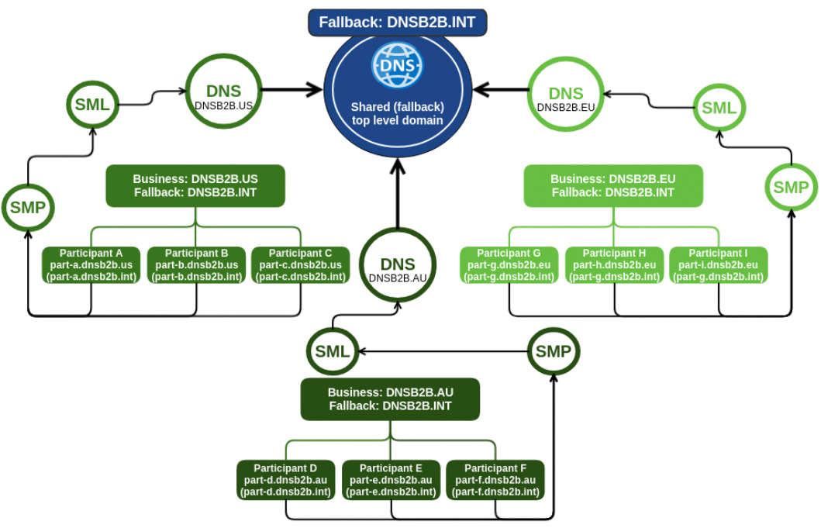
B-1: Federated Registry services using fallback
Advantages:
Smaller regional DNS zones (lower DNS maintenance costs).
SML service providers can easily operate only the regional DNS service.
Global discovery can be provided as additional service by the regional SML service provider.
Technology exists today without modification.
Technology is well known, well understood and robust, with established mechanisms.
Small retry/fallback change to existing discovery model for the regional discovery.
The upgrade of the discovery clients/libraries to be able to use an additional top domain is not complex.
Disadvantages:
• The discovery clients must be able to configure two top DNS domains: regional top domain and
international top domain.
• It is not immediately clear who operates the international DNS zone
The regions can each have their own trusted top domains, and one international fallback domain. The lookup process would work by participants first trying to discover a recipient via the regional DNS top domain and, if this fails, then via the international DNS top domain.

Slide 8
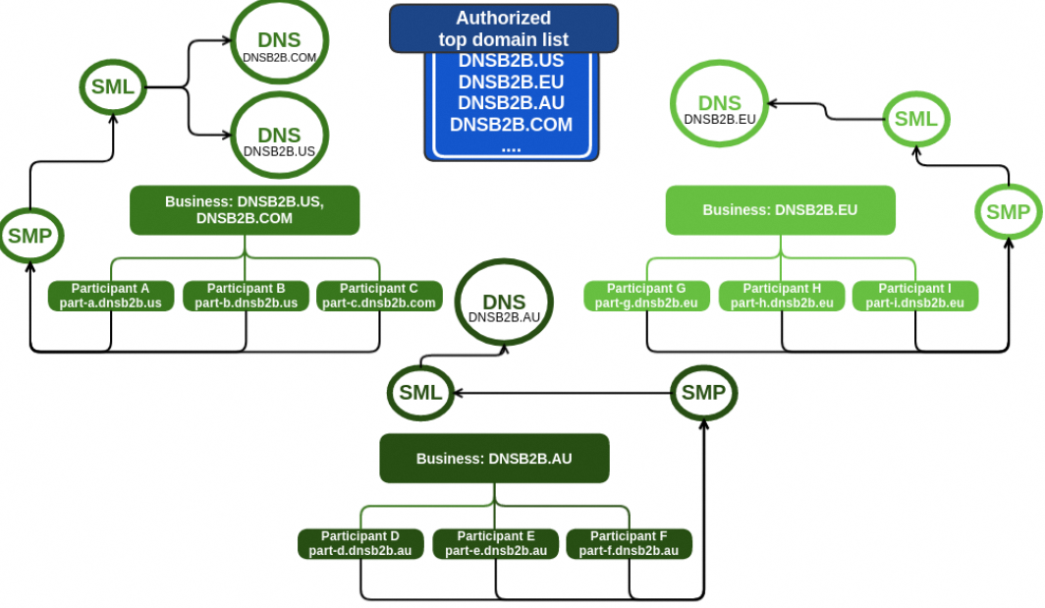
B-2: Federated Registry services using list of domains
Advantages:
Smaller regional DNS zones (lower DNS maintenance costs).
SML service providers can easily operate only the regional DNS service.
Allows for true federated registries.
Technology exists today without modification.
Technology is well known, well understood and robust, with established mechanisms.
No change to existing discovery model for the regional discovery.
Allows simple or more sophisticated implementation of top domain retry mechanism.
A list of authorized DNS domains that offer SML DNS services
If dynamic discovery does not resolve one DNS domain, it can try the next one in the list, etc. The list order can be different for various regions to increase lookup efficiency.
Disadvantages:
To be useful for global network discovery, the discovery clients must be able to configure a top DNS domain list.
An enhancement is needed for discovery clients to establish the best top domain list search order.
When using non-global party identifiers, the same party identifier can be used in different SML service
providers for different participants. To prevent this issue, the exchange network should use only party identifiers using international standards, such as ISO6523.

Slide 9
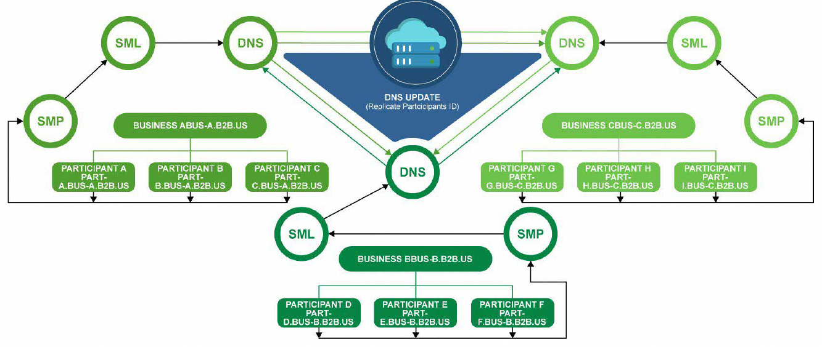
C-1: Federated Registry services using Unique Domain scheme for each registry
Advantages:
1) Allows for true federated registries.
2) Technology exists today without modification.
3) Technology is well known, well understood and robust, with established mechanisms for management.
4) Could prove this concept with current work group resources.
5) No change to existing discovery model.
Disadvantages:
1) Potential scalability concerns with a star configuration of replication and NSUPDATE commands.
2) Every participant ID is replicated to every registry, which could cause participant information to be out of sync.
3) Moving to a different SML service can be difficult and complex – needs both SML service providers to cooperate fully.
4) DNS poses potential issue with latency when propagating around the world.
Each SML uses its own domain name
Participants are replicated across all SML or a new discovery model needed

Slide 10
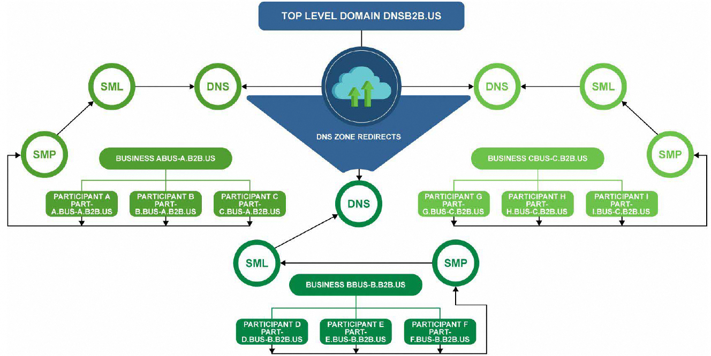
C-2: Federated Registry services using a shared top-level Domain
Advantages:
1) Eliminates complex nsupdate methodologies for keeping participant IDs in sync.
2) Sub domain zone hosting can be moved back to registrars completely to give each registrar complete control over their registry.
3) Participant IDs only exist in one registry (no replication), reducing scalability concerns with option 1.
4) Could prove this concept with current work group resources.
5) Technology exists today to support this model.
6) Technology is well known, well understood and robust, with established mechanisms for management.
7) No change to existing discovery model.
Disadvantages:
1) Additional costs required to support top level domain; central ownership of the top-level domain can be contracted out using a registrar fee-based system to pay for costs.
2) Participant ID searching can impact performance as the network scales out. (Though may be manageable.)
3) Changing SML Service Providers has significant complexity that may be unmanageable.
4) DNS poses potential issue with latency when propagating around the world.
5) Can we effectively provide a technical solution that supports a business process for modifications/updates to the registry (e.g. business rules are enforced through a technical solution, not through business process alone)?
Each SML has a sub-domain underneath. Replication is not used between SMLs.

Slide 11
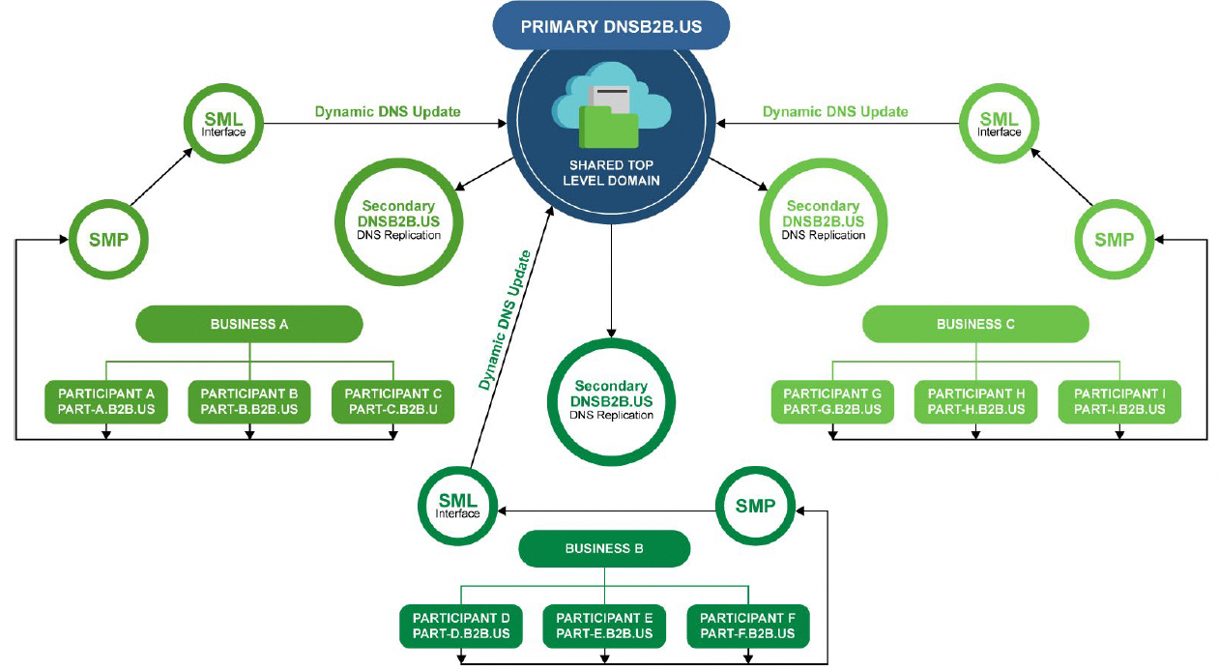
C-3: Hybrid of 1 and 2 - Federated Registry services using a top-level Domain scheme and secondary DNS servers
Advantages:
1) Reduces complexity with nsupdate methodologies that replicate only to top level domain, not each other.
2) Essentially only one registry, but with multiple owners, reduces complex searching for participants.
3) Could prove this concept with current work group resources.
4) No change to existing discovery model.
5) Fairly low additional costs (compared to option 1) for top level domain management (only a primary DNS management is needed.)
6) Changing SML service providers has low complexity/barriers.
7) Technology exists today to support this model.
8) Technology is well known, well understood and robust, with established mechanisms for management.
9) Supports reduction of fraud.
Disadvantages:
1) Additional costs required to support top level domain primary DNS controller.
2) Very clearly defined rules on updates to registry must be defined and followed, could create legal complexity.
3) DNS poses potential issue with latency when propagating around the world.
4) Can we effectively provide a technical solution that enforces a business process for modifications/updates to the registry (e.g. business rules are enforced through a technical solution, not through business process alone)?
Details: Top level domain scheme for all participants; SML service providers host secondary DNS servers that use NSUPDATE to provide changes.

Slide 12
Discussion of the Preferred Options
Option A: No SML from Jelte
Option B: Options from Joze Rihtarsic, EC DG DIGIT
Option C: DBNA/BPC study options

