Slide 1
France DCTCE PoC
E-delivery CMB
12 July 2023

Slide 2
Agenda Items
PoC Approach
Phase 1
Technical
Timelines
Questions

Slide 3
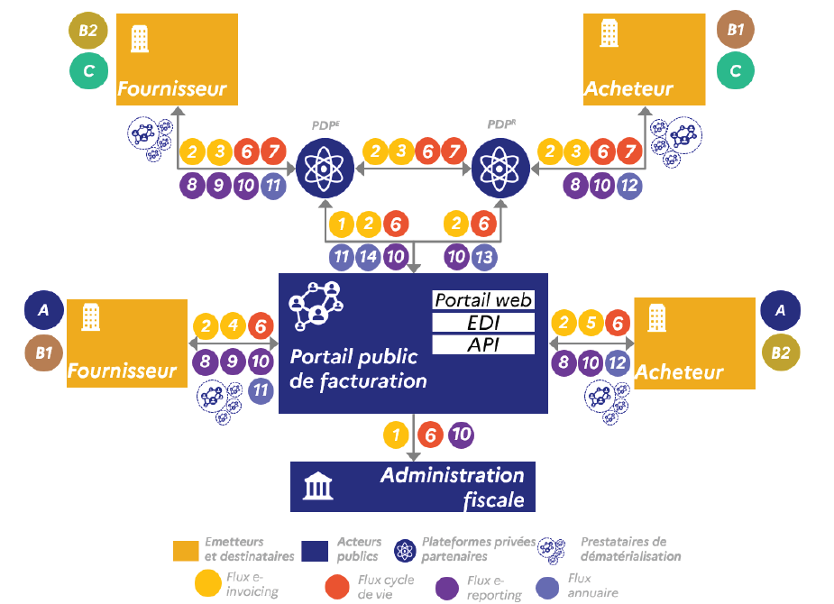
PoC Approach – French Architecture
The PoC will only include the messages exchanged in Circuit C, this is in effect from PDP to PDP.
The following specific flows are under consideration;
2 – e-invoice
6/7 – Lifecycle messages
8/9/10 – e-Reporting. Until a connection with the PPF is achieved this is out of scope

Slide 4
PoC Approach
A systematic, coordinated and inclusive approach
This remains a joint EESPA/OpenPeppol project
Gradually moving towards the complete solution when there are still some unknowns with respect to the exact French requirement
As this is a PoC - the opportunity should be taken to test a number of options.

Slide 5
Documentation & Support
1. Following documents are now available online and have been updated as issues have been identified and fixed;
PoC How to Guide
PoC Handbook
PoC Exchange and Results
PoC List of Participants
FAQ Being updated
2. Dedicated Project email up and running with a participant distribution list - a number of updates have already been provided
3. Slack Technical site is proving to be very useful and some good exchange taking place

Slide 6
Phased Approach – Phase 1
Aim is to take a phased approach to the PoC
The precise scope of each individual phase will be determined within the Project Team and be updated as and when
previous phases have been completed by at least some participants
when increased functionality becomes available,
Participants prioritise flows and/or formats based on their interests
Initial test will be limited to flows between PDPs
The goal is to test how to allow PDP to exchange documents over the Peppol Network.
Different PoC participants may start with different formats
The type of documents that will be exchanged in the first phase are currently limited to;
E-invoices and Credit Notes
Technical Acknowledgement messages

Slide 7
Phase 1 Results - Assessment
Large element of Self testing has taken place
A couple of minor technical issues – Oxalis
One more major outage of the Test SMP for 36Hrs - fixed
Significant scenario testing has been carried out and appears successful
Successful Exchange of UBL/CII and Factur-X tests
Most of the 21 SPs with SMPs have provided responses to request for updates
Total of 31 Providers have Test certificates;
Still leaves 9 Providers who have yet to apply for a PoC Test Certificate
Phase 1 testing is still on-going

Slide 8
Technical Update
Current Issues
None to report
Invoice Message Response/CDAR
DGFIP/AIFE yet to finalise specification
Update IMR to match CDAR specs
Use cases included in recent Handbook Update
Peppol Native
Update SBDH Envelope approach
Handbook change ready
This will be in addition to current UBL Attachment
Peppol BIS 3.0
Update Peppol BIS 3.0 format to include all Fr e-invoicing requirements noting complicated address information

Slide 9
Timelines
Slightly amended timelines for the phases;
Phase 1 – Simple E-invoice exchange (Ideally completed end of June)
Phase 2 – Lifecycle Message and Use of Native Peppol Format (Ideally completed by end of July)
Phase 3 – Other invoices types, updated Peppol IMR to include final CDAR requirements and also use of Peppol BIS 3.0 Format (Ideally completed by end of August/Sep
Phase 4 – Coordination with DGFIP Pilot and dummy Directory??
Reporting has been introduced to match these dates – in effect monthly reporting
Note that proposal is now to include the Peppol Native testing as part of Phase 2 as participants are able and wish to
Whilst final version of CDAR Spec will not now be available until 15 July, the Handbook has now been updated with used cases based on current known spec to allow participants to test CDAR in advance of formal final version should they wish

Slide 10
PoC Participants - Overview
Currently 47 SPS have committed to participating in the PoC (plus 2)
Of these 39 are member of the FNFE
31 SPs have now received the Test Certificates (plus 4)
21 have SMP registrations (plus 5)
14 countries represented;
France (23), Belgium (4), Sweden (3), Spain (2), Germany (2), Italy (2), USA (2), Denmark, Finland, Switzerland, Portugal, UK, Holland, Poland

Slide 11
PoC Participants – Testing Groups
Testing Groups have been established 20 separate participants;
B2BRouter/MySupply/Basware
SERES, CEGEDIM, AGENA3000, DOXIO, Pennylane, Arteva – Inposia – Agena 3000
Arteva – Inposia – Agena 3000
Esker/Tradeshift
Tessi/Unified Post
B2BRouter- Basware - My Supply - Pagero
TIEKINETIX/B2BROUTER/INPOSIA
Quadient/Tickstar

Slide 12
Phase 2
Continue Flexible approach - to begin 1 July
Continue any outstanding Phase 1 Tests
Allow CDAR testing in advance of final formal spec being available
Peppol Native format using the updated SBDH Envelope will be available
The Handbook is currently being updated to incorporate current CDAR uses cases and Peppol Native
Following communications are envisaged;
Email to all participants later today informing of Phase 2 approach
Email to all participants when Handbook has been uploaded

Slide 13
Follow on phase
These will be introduced on a rolling basis as time is right;
Non-regulated flows and use of Peppol BIS (e.g. cross-border)
Include the Annuaire
Include the PPF and eRerporting
Look at the possibility of connecting the PPF to Peppol and test regulated flow PPF-PDP if determined possible by DGFIP/AIFE

Slide 14
DGFIP PDP and OD Pilot
FrGovt is running a separate Pilot;
Registration will need to be completed by end of June
Note candidate ODs will be included in this Pilot
Beginning of Sep – meeting with successful SPs Kick Off Meeting
Go Live date 3 Jan 2024
We have provided a single page word document to all the PoC participants which can be inserted into Peppol APs application to underline the need to include requirement to fully test InterOperations. We will be asking participants to let us know how many used this information.
We will also look at e2e testing in a more collaborative way with DGFIP/AIFE as part of their Pilot.
This can only be achieved once we have had a successful PoC – when timings are right a f2f meeting will be arranged with DGFIP/AIFE to brief on Poc and look at being involved in their testing schedule

Slide 15
Project Overview
Documentation - Finalised and being updated as required
Project Team is now complete
Certification process is now smooth
Timeline
Technical solutions now understood and clearer
Technical support with dedicated email and Slack in place
Ready to start testing
Ongoing Technical work – IMR/CDAR analysis
Ongoing Technical work – Peppol Native (update SBDH Header)
Ongoing Technical work – Peppol Bis 3.0

Slide 16
Questions ????

