Slide 1
PEPPOL European Norm for E-invoicing
Martin Forsberg

Slide 2
Agenda
Overview of the BIS Billing 3.0
CIUS concept and validation
Migration plan
Discussion

Slide 3
PEPPOL BIS Billing 3.0
Current status

Slide 4
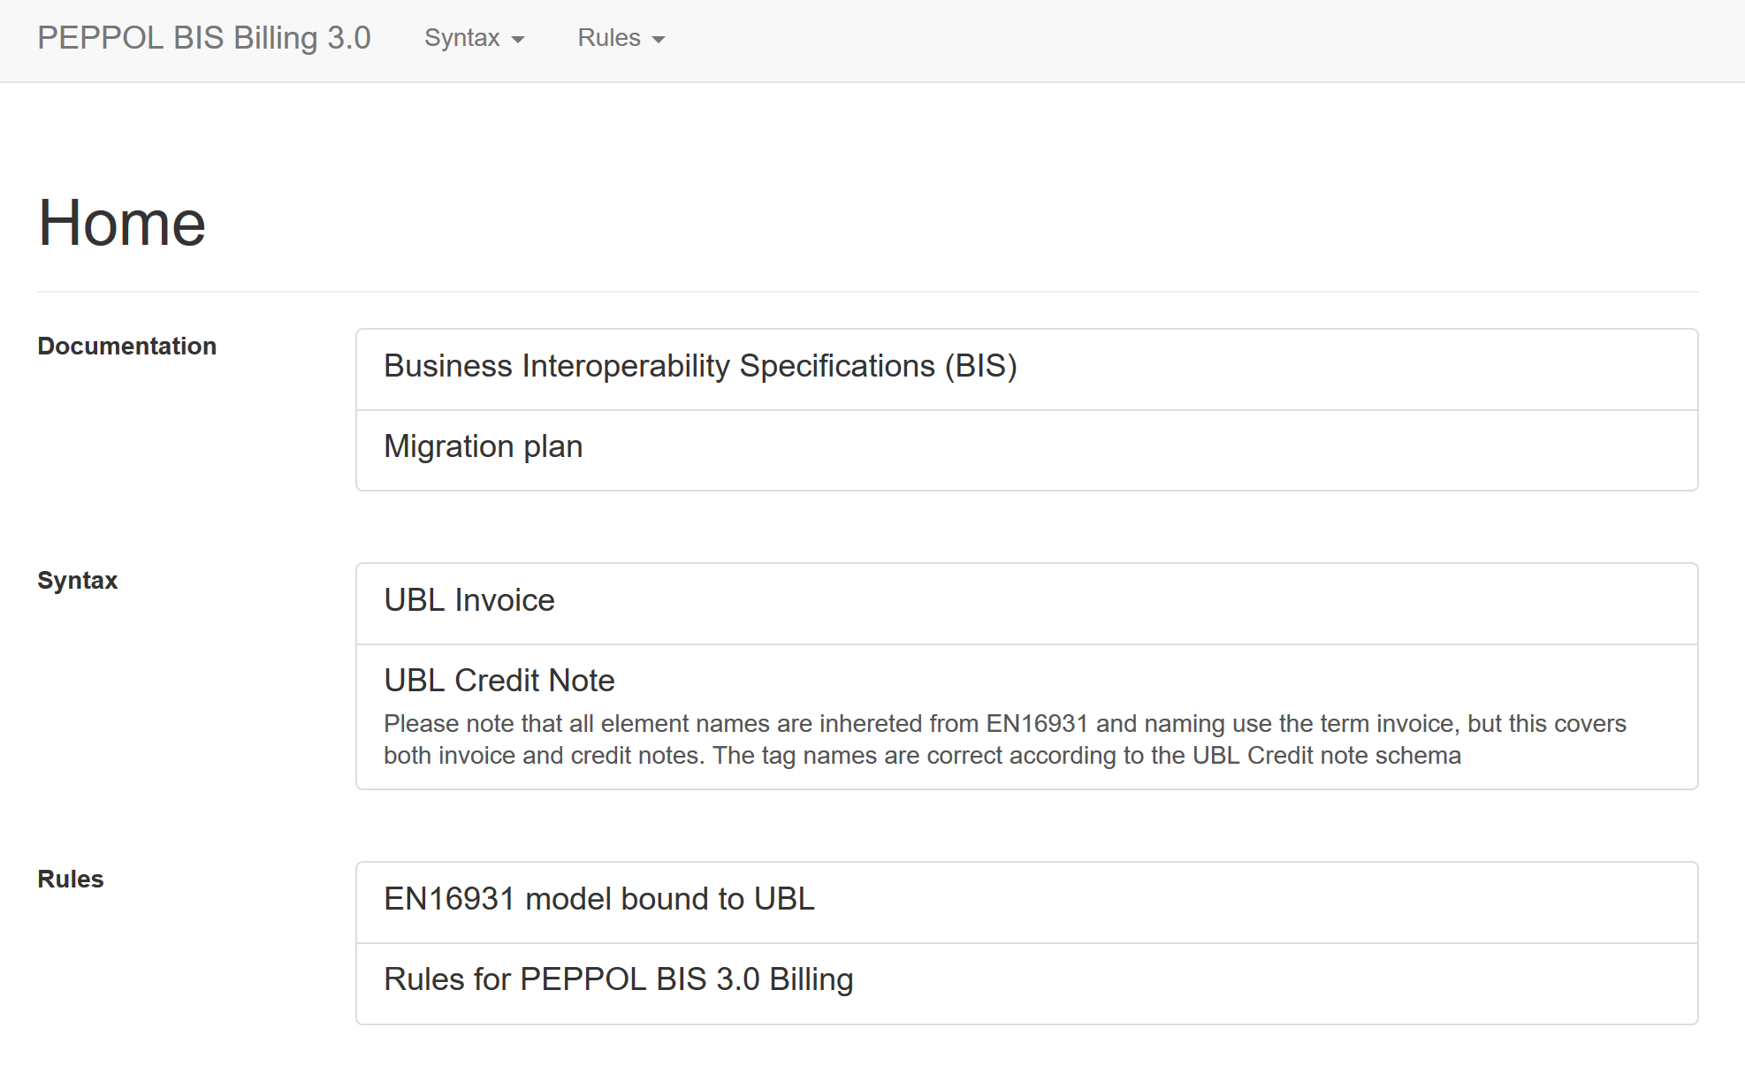
Published and ready for use
http://docs.peppol.eu/poacc/billing/3.0/

Slide 5
CIUS Challenge and the PEPPOL Solution

Slide 6
The directive – Requirements for the contracting authorities/entities
From article 7
Receipt and processing of electronic invoices
Member States shall ensure that contracting authorities and contracting entities receive and process electronic invoices which comply with the European standard on electronic invoicing whose reference has been published pursuant to Article 3(2) and with any of the syntaxes on the list published pursuant to Article 3(2).

Slide 7
European Norm for e-invoicing and relevant technical specifications
Consists of
semantic data model incl business rules (European Norm)
list of syntaxes (Technical Specification)
syntax binding for each syntax (Technical Specification)
other supporting specifications and guides (Technical Reports)

Slide 8
Claiming compliance towards the norm
Compliance of sending or receiving party
A receiving party may only claim compliance to the core invoice model if he accepts invoices that comply with the core invoice model in general, or with a CIUS, that is itself compliant with the core invoice model.
Conformance of an invoice document instance
An invoice document instance is conformant to the core invoice model if it respects all rules defined for the core invoice model, which may include the specification contained in a conformant CIUS.

Slide 9
Compliance – Usage Specifications
The norm allows for (Core Invoice) Usage Specifications – CIUS
A CIUS can be compared to an implementation guide
A CIUS must be a true subset of the norm – meaning it must follow all business rules and can’t add any terms not already defined (that would require an Extension)
A CIUS can range from a simple restriction like
”The seller MUST provide a contract reference”
To more complex specifications
Restrictions of cardinalities
Subset of codelists
Length restrictions of text elements

Slide 10
What is allowed to restrict in a Core Invoice Usage Specification
”Forbid” optional elements 0..n/0..1 ➔ 0..0
Make definition narrower
Add synonyms or explanatory text
Make optional element mandatory
Limit allowed number of repetitions
Change data type to narrower representation (alphanumeric ➔ numeric)
Limited allowed code values
Add additional business rules or make existing more restrictive
Restrict field lengths
Require certain formatting on values
Restrict number of decimals/fractions
IMPORTANT
An invoice which follows a CIUS MUST ALWAYS also be compliant towards the (non-restricted) norm.

Slide 11
A few scenarios
Using EN as is
All instances should be possible to accept
All instances should be possible to accept
Using CIUS SE
All instances should be possible to accept
Supports EN fully
All instances may not be possible to accept
Using CIUS NL
Example: The extension has added a code for a Invoice Type which is not supported in the EN and the receiver will not understand its purpose
Using Extension
Assuming the invoices are conformant against its specifcation (EN/CIUS/Extension)

Slide 12
A few more scenarios
Example: The issuer may use a feature from the EN which has been restricted in the CIUS
Using EN as is
All instances may not be possible to accept
All instances should be possible to accept
Using CIUS SE
All instances may not be possible to accept
Supports CIUS SE only
All instances may not be possible to accept
Using CIUS NL
Example: The extension has added a code for a Invoice Type which is not supported in the EN and the receiver will not understand its purpose
Using Extension
Assuming the invoices are conformant against its specifcation (EN/CIUS/Extension)

Slide 13
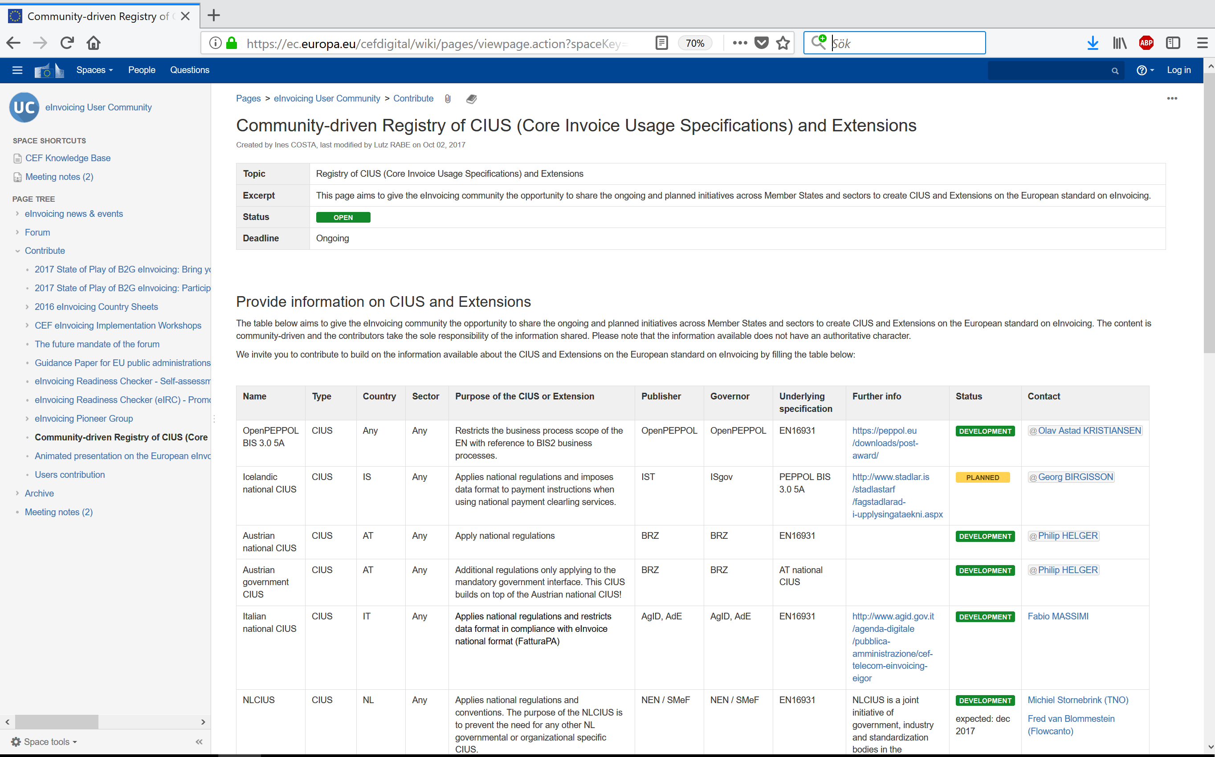
List of CIUS projects

Slide 14
General rules and country-qualified rules
A general rule applies for all invoices
The rule is triggered by the existence of a spefic business term
A country-qualified rule applies only for invoices issued in a specific country
The rule is triggered by the given country code of the seller
Rule text from the standard
In an Invoice line where the Invoice item VAT category code (BT-151) is “Export outside the EU” the Invoiced item VAT rate (BT-152) shall be 0 (zero).
Context (what triggers the rule)
Existence of InvoiceLine/Item/ClassifiedTax/CategoryCode=‘XYZ’
Example rule text from a CIUS
The Seller Name must not have more than 50 characters
Context (what triggers the rule)
Existence of
Seller/Name
Example rule text from a Country specific CIUS
When the Seller is Swedish, the Legal Registration Number must be numeric with 10 digits.
Context (what triggers the rule)
Existence of
Seller/Address/CountryCode=‘SE’
AND existence of Seller/LegalRegistrationNumber

Slide 15
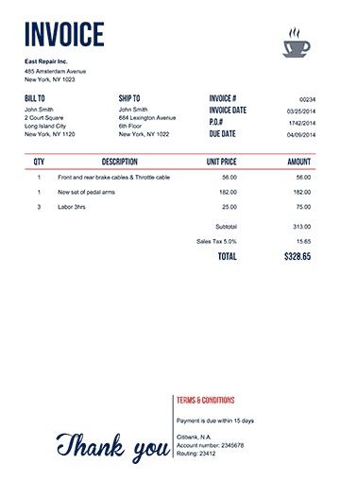
Layers of validation rules in PEPPOL
XML Well-formedness Basic XML
XML Schema XML Invoice Standard (UBL/CII)
CEN TC/434
EN + Syntax specific rules
PEPPOL CIUS
PEPPOL General Rules
CIUS-Country qualified rules
Country Specific
Country Specific
Country Specific
Country Specific
Compliant!
Compliant!

Slide 16
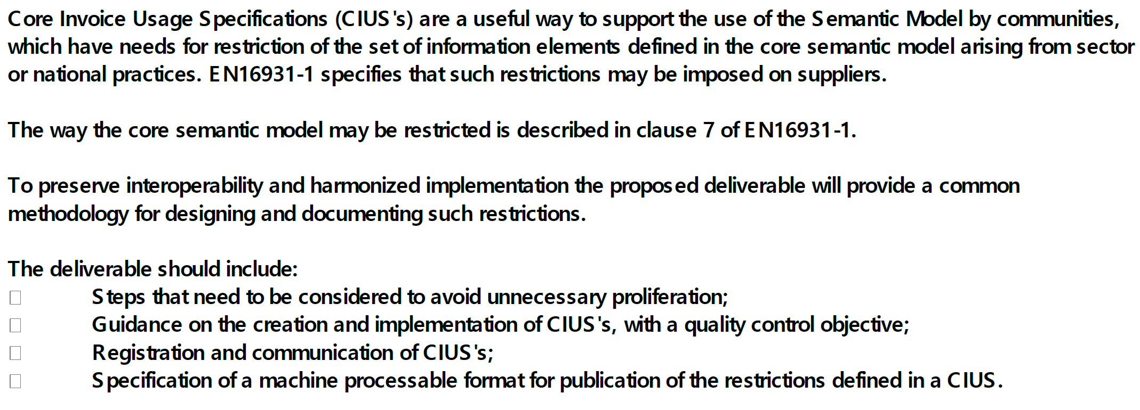
Proposed development in TC434

Slide 17
Migration plan

Slide 18
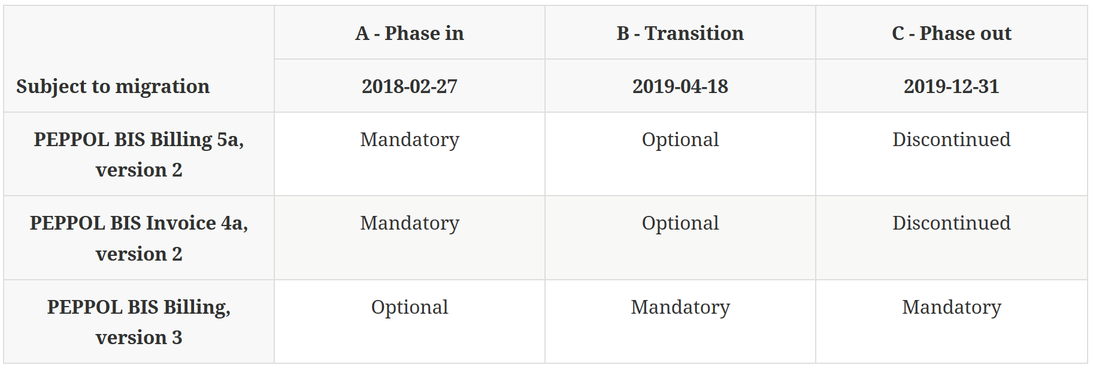
Approved migration plan

Slide 19
Migration from BIS V2 to European Norm
Document ID taken out from Policy For Identifiers
A. 2018-02-27
B. 2018-04-18
C. 2019-12-31
Policy for mandatory use
Not Allowed
BIS V2
In use - Mandatory
In production – Mandatory and
New – optional
Phase out - optional
BIS V3
Take up – optional
In use - Mandatory
Participants/ End users
!
!
!
! = New
End user Service Metadata with BIS V2 only (Mandatory)
End user Service Metadata with both BIS V2 and BIS V3 (optional for new/mandatory for existing)
End user Service Metadata with with BIS V3 (Mandatory)

Slide 20
Discussion – buyer specific rules

Slide 21
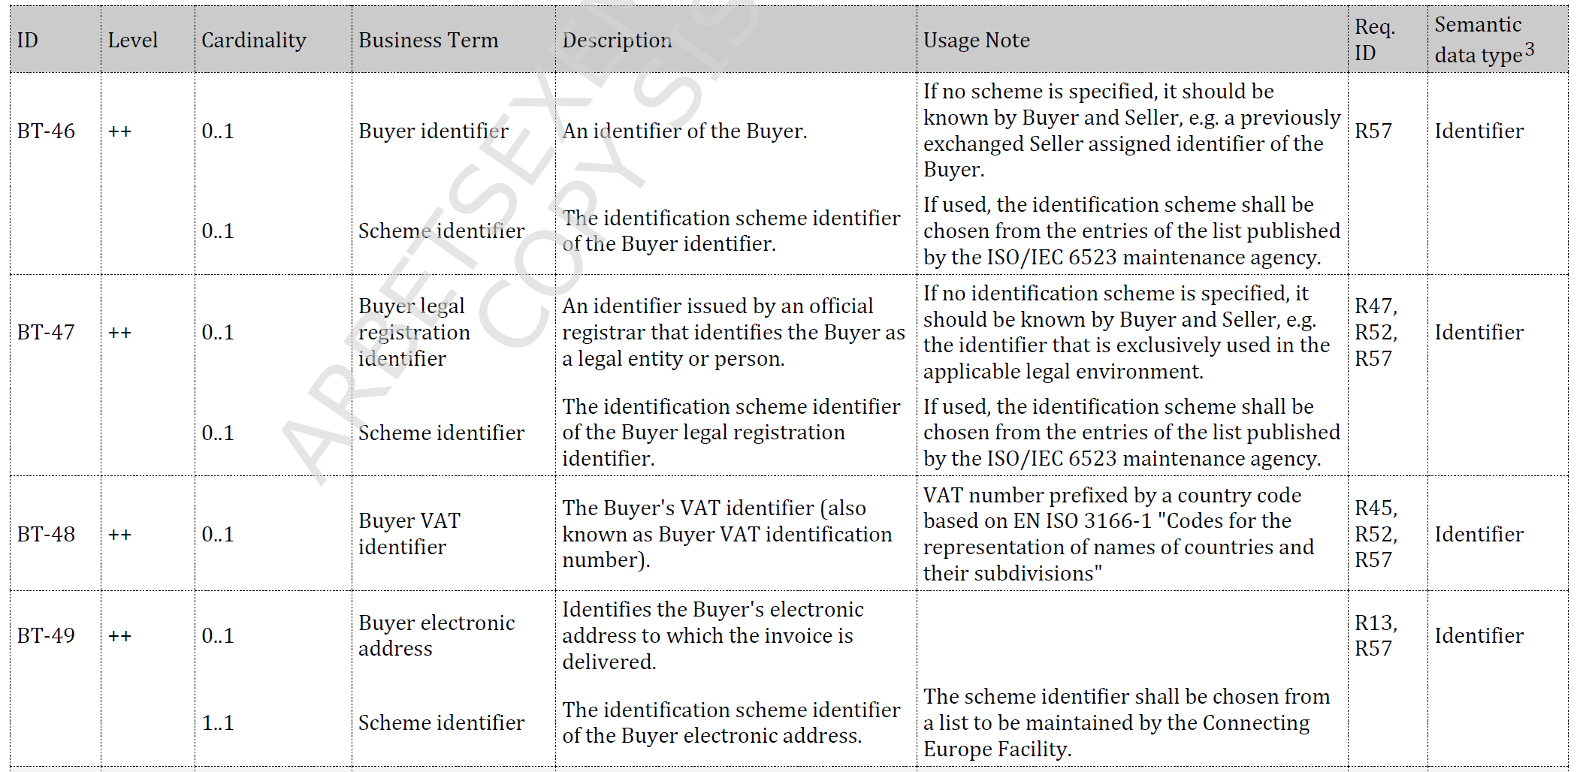
Buyer specific rules
Requests have been received to reconsider the current approach to also enable country specific rules which are triggered by the buyer country
Currently this is not possible as it has been seen as adding complexity
Proposal to limit the rules to limit hos to enter buyer business term

