Slide 1
Introduction to PEPPOL BIS and eDelivery

Slide 2
Important concepts
OpenPEPPOL
Access Point
PEPPOL BIS
AS2
AS4
Service Providers
European Core Invoice Standard
Dynamic Discovery
CIUS!!
TIA (Transport Infrastructure Agreement)
Schematron
SMP (Service Metadata Publisher)
SML (Service Metadata Locator)

Slide 3
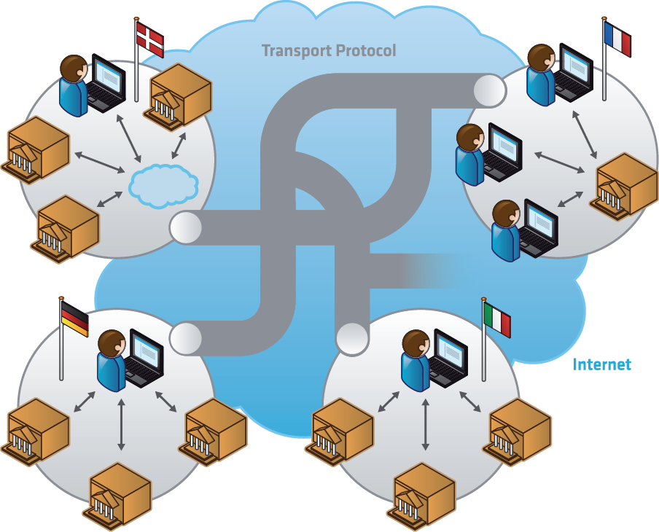
The PEPPOL Vision
Any supplier (incl. SMEs) in the EU can communicate electronically with any European contracting authority for all procurement processes.

Slide 4
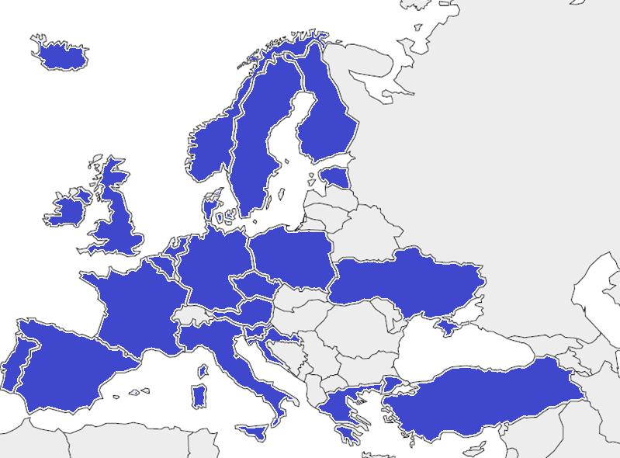

PEPPOL eDelivery network today
188+ Access Point providers
in more than 20 European countries, plus
Canada and USA
10 PEPPOL Authorities
  AGID (Italy)
  Department of Health (UK)
  Difi (Norway)
  DIGST (Denmark)
  ESV (Sweden)
  Fedict (Belgium)
  Ministry of Economic Development (Poland)
  OpenPEPPOL AISBL
  SimplerInvoicing (Netherlands)
  Ireland
  OpenPEPPOL members
  from more than 25 countries

Slide 5
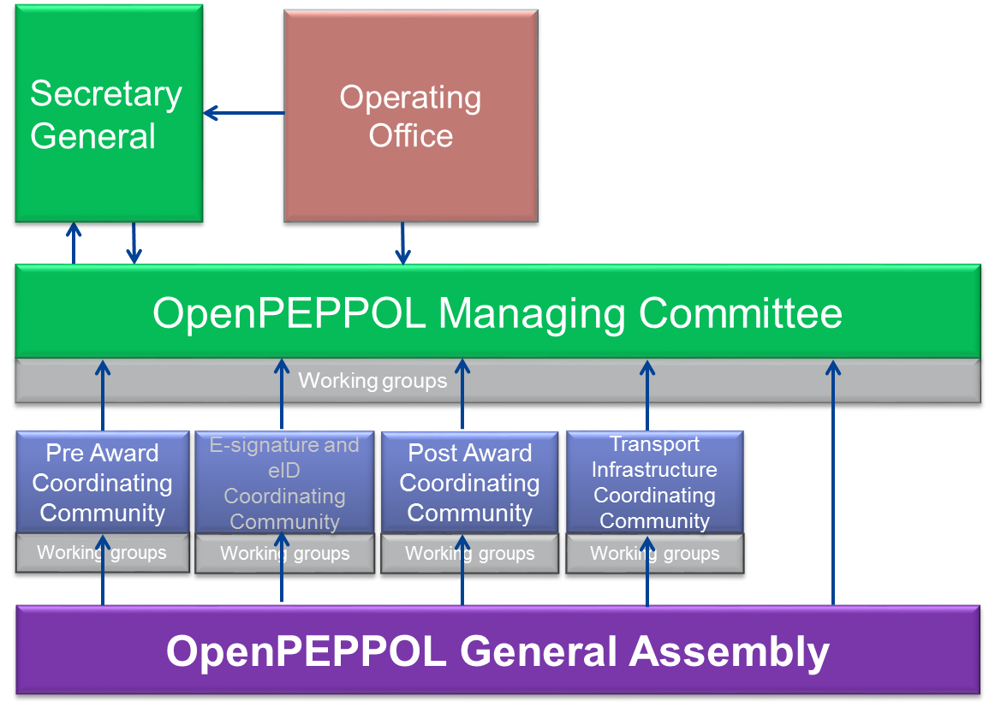
OpenPEPPOL Organisation
André Hoddevik (difi)
Lafteris Leontaridis ( Netsmart) – Operations Manager
Anna-Lis Berg ( DIFI)
Mairi Hayworth (penmarin) - BOM
Clara Møller-Nielsen (Drop Byrden) - BAM
Jostein Frømyr ( DIFI) – Agreement Coordinator
André Hoddevik (difi) SC
Sören Pedersen (ESV) POACC
Hans Berg (Tickstar) TICC
Isabella Rapisarda (Consip) PRACC
Niels Pagh-Rasmussen (IBM)
Steve Graham ( NHS)
All Members

Slide 6
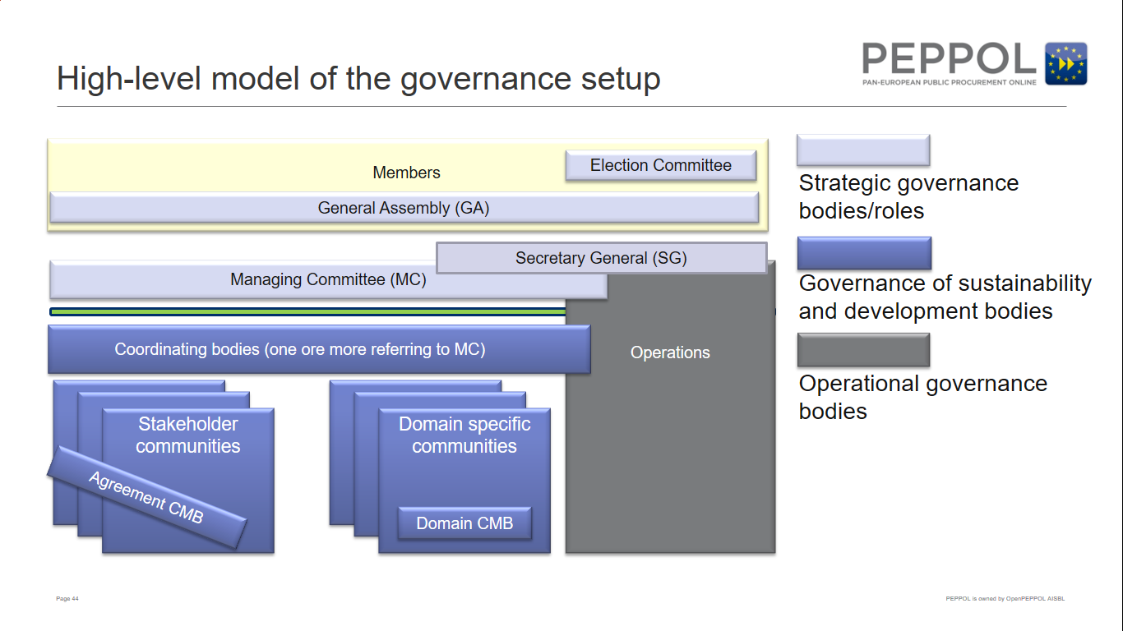

Slide 7
PEPPOL Infrastructure and CEF eDelivery
Martin Forsberg

Slide 8
1. | A short introduction to the (former) challenges in electronic business
2. | The CEF eDelivery Discovery Model/PEPPOL approach
3. | Consequences for the users
4. | Scalability of the infrastructure
5. | Technical specifications

Slide 9
A short introduction to the (former) challenges in electronic business
1

Slide 10
How it used to work…
Buyer
Seller
Buyer
Seller
Buyer
Seller
Buyer
Seller
Buyer
Seller
Bilaterally agreed configuration of format, protocol, security
In-house IT-solutions
Each new connection => a project

Slide 11
How it used to work…
Buyer
Seller
Buyer
Seller
Buyer
Hub service
Seller
Buyer
Seller
Buyer
Seller
Central hub takes care of the routing
Buyer and seller become customers of the hub
Business partners must use the same hub

Slide 12
How it used to work…
Hub service
Buyer
Seller
Buyer
Seller
Hub service
Buyer
Hub service
Seller
Buyer
Seller
Hub service
Buyer
Seller
Central hub takes care of the routing
Buyer and seller become customers of the hub
Business partners must use the same hub

Slide 13
How it used to work…
Buyer
Seller
Service Provider
Service Provider
Buyer
Seller
Buyer
Seller
Service Provider
Service Provider
Buyer
Seller
Service Provider
Buyer
Seller
Service providers acting on behalf of the buyer or seller
End point (addressing)-information stored by the service provider
or the issuer
Have collaboration-agreements defining SLA, technical details…

Slide 14
How it used to work…
Collaboration agreements
Buyer
Seller
Service Provider
Service Provider
Buyer
Seller
Buyer
Seller
Service Provider
Service Provider
Buyer
Seller
Service Provider
Buyer
Seller
Service providers acting on behalf of the buyer or seller
End point (addressing)-information stored by the service provider
or the issuer
Have collaboration-agreements defining SLA, technical details…

Slide 15
Typical problems we see today
Complex process to connect new business partners
Very costly to configure new connections
Hard to know which format/standard is used for messages
Almost impossible to connect cross-border in a rational way
All service providers don’t collaborate
Very costly to change service provider

Slide 16
The CEF eDelivery Discovery Model approach
2

Slide 17
Discovery models
CEF eDelivery
Static
Dynamic
In a Static Service Location model the IP address and related attributes are static. The IP address of all the Access Points in the network are stored on a central location for the other Access Points to reference. To send a message, the sending Access Point looks a the static list of IP addresses on the networks’ Domain Name System (DNS) to locate the Access Point of the receiver.
Dynamic Service Location enables the sending AP to dynamically discover the IP address and capabilities of the receiver. Instead of looking at a static list of IP addresses, the sender consults a Service Metadata Publisher (SMP) where information about every participant in the data exchange network is kept up to date. As at any point in time there can be several SMPs, every participant must be given a unique ID that must be published by the Service Metadata Locator (SML) on the network’s Domain Name System (DNS). By knowing this URL, the sender is able to dynamically locate the right SMP and therefore the right receiver.
+
High speed as there is no overhead processing
+
More automated and flexible
PROS & CONS
-
Slower speed, as some overhead processing is required
-
Less flexible, change of irrelevant references

Slide 18
PEPPOL – A deployment of CEF eDelivery DSI
AP
The role of the AP (Access Point) is to send and receive messages in a secure and reliable way, on behalf of the participants. The AP is essentially a simple which is often offered together with other value added services by a service provider.
SMP
Once the sender discovers the address of the receiver’s SMP, it is able to retrieve the needed information (i.e. metadata) about the receiver. With such information, the message can be sent. The SMP is usually a distributed component in an eDelivery Messaging Infrastructure.
SML
The role of the SML (Service Metadata Locator) is to manage the resource records of the participants and SMPs (Service Metadata Publisher) in the DNS (Domain Name System). The SML is usually a centralised component in an eDelivery Messaging Infrastructure.
Seller
Participant
C1
C4
Participant
Buyer
ORIGINAL SENDER
FINAL RECIPIENT
SML
(centralised)
Access Point Provider
C2
C3
Access Point Provider
DNS
Access
Point
Access
Point
Internet
SMP
SMP

Slide 19


Transport Infrastructure Agreements (TIA)
OpenPEPPOL AISBL
The Access Point Provider and the Service Metadata Publisher Provider must sign a contract with OpenPEPPOL (or any of the PEPPOL Authorities)
Agreements defines responsibilities, expectations, service levels and more
Only providers who have signed the agreements can participate in the network (controlled by digital certificates on a communication level)
Community Agreement
PEPPOL-Authorities (SE, IT, BE
NL, UK, NO, DK…)
Provider Agreement
Service providers

Slide 20
Dynamic discovery in detail
Phase 1: Registration
SML
The role of the SML (Service Metadata Locator) is to manage the resource records of the participants and SMPs (Service Metadata Publisher) in the DNS (Domain Name System). The SML is usually a centralised component in an eDelivery Messaging Infrastructure.
SMP
Once the sender discovers the address of the receiver’s SMP, it is able to retrieve the needed information (i.e. metadata) about the receiver. With such information, the message can be sent. The SMP is usually a distributed component in an eDelivery Messaging Infrastructure.
Seller
Participant
C1
C4
Participant
Buyer
ORIGINAL SENDER
FINAL RECIPIENT
SML
(centralised)
Access Point Provider
C2
C3
Access Point Provider
DNS
Access
Point
Access
Point
Internet
SMP
SMP
ADMINISTRATOR
STEP 1. SUBMIT METADATA
1. Buyer ID, Supported Message type and End point is published

Slide 21
Dynamic discovery in detail
Phase 1: Registration
SML
The role of the SML (Service Metadata Locator) is to manage the resource records of the participants and SMPs (Service Metadata Publisher) in the DNS (Domain Name System). The SML is usually a centralised component in an eDelivery Messaging Infrastructure.
SMP
Once the sender discovers the address of the receiver’s SMP, it is able to retrieve the needed information (i.e. metadata) about the receiver. With such information, the message can be sent. The SMP is usually a distributed component in an eDelivery Messaging Infrastructure.
Seller
Participant
C1
C4
Participant
Buyer
ORIGINAL SENDER
FINAL RECIPIENT
SML
(centralised)
Access Point Provider
C2
C3
Access Point Provider
DNS
Access
Point
Access
Point
STEP 2. CREATE PARTICIPANT
Internet
SMP
SMP
ADMINISTRATOR
STEP 1. SUBMIT METADATA
1. Buyer ID, Supported Message type and End point is published
2. The SMP creates a record in the SML which associates the participant with the SMP

Slide 22
Dynamic discovery in detail
Phase 1: Registration
SML
The role of the SML (Service Metadata Locator) is to manage the resource records of the participants and SMPs (Service Metadata Publisher) in the DNS (Domain Name System). The SML is usually a centralised component in an eDelivery Messaging Infrastructure.
SMP
Once the sender discovers the address of the receiver’s SMP, it is able to retrieve the needed information (i.e. metadata) about the receiver. With such information, the message can be sent. The SMP is usually a distributed component in an eDelivery Messaging Infrastructure.
Seller
Participant
C1
C4
Participant
Buyer
ORIGINAL SENDER
FINAL RECIPIENT
STEP 3. REGISTER PARTICIPANT
SML
(centralised)
Access Point Provider
C2
C3
Access Point Provider
DNS
Access
Point
Access
Point
STEP 2. CREATE PARTICIPANT
Internet
SMP
SMP
ADMINISTRATOR
STEP 1. SUBMIT METADATA
1. Buyer ID, Supported Message type and End point is published
2. The SMP creates a record in the SML which associates the participant with the SMP
3. The SML updates the DNS which creates a DNS record for the participant, pointing to the SMP

Slide 23
Dynamic discovery in detail
Phase 2: Operations
SML
The role of the SML (Service Metadata Locator) is to manage the resource records of the participants and SMPs (Service Metadata Publisher) in the DNS (Domain Name System). The SML is usually a centralised component in an eDelivery Messaging Infrastructure.
SMP
Once the sender discovers the address of the receiver’s SMP, it is able to retrieve the needed information (i.e. metadata) about the receiver. With such information, the message can be sent. The SMP is usually a distributed component in an eDelivery Messaging Infrastructure.
Seller
Participant
C1
C4
Participant
Buyer
STEP 1. SUBMIT
ORIGINAL SENDER
FINAL RECIPIENT
SML
(centralised)
Access Point Provider
C2
C3
Access Point Provider
DNS
Access
Point
Access
Point
Internet
SMP
SMP
1. Seller issues an eInvoice (or other eDocument) and hands it over to the AP

Slide 24
Dynamic discovery in detail
Phase 2: Operations
SML
The role of the SML (Service Metadata Locator) is to manage the resource records of the participants and SMPs (Service Metadata Publisher) in the DNS (Domain Name System). The SML is usually a centralised component in an eDelivery Messaging Infrastructure.
SMP
Once the sender discovers the address of the receiver’s SMP, it is able to retrieve the needed information (i.e. metadata) about the receiver. With such information, the message can be sent. The SMP is usually a distributed component in an eDelivery Messaging Infrastructure.
Seller
Participant
C1
C4
Participant
Buyer
STEP 1. SUBMIT
ORIGINAL SENDER
FINAL RECIPIENT
SML
(centralised)
Access Point Provider
C2
C3
Access Point Provider
STEP 2. LOOKUP
DNS
Access
Point
Access
Point
Internet
SMP
SMP
1. Seller issues an eInvoice (or other eDocument) and hands it over to the AP
2. The AP makes a lookup using a HTTP GET. The DNS directs the AP to the participant’s SMP

Slide 25
Dynamic discovery in detail
Phase 2: Operations
SML
The role of the SML (Service Metadata Locator) is to manage the resource records of the participants and SMPs (Service Metadata Publisher) in the DNS (Domain Name System). The SML is usually a centralised component in an eDelivery Messaging Infrastructure.
SMP
Once the sender discovers the address of the receiver’s SMP, it is able to retrieve the needed information (i.e. metadata) about the receiver. With such information, the message can be sent. The SMP is usually a distributed component in an eDelivery Messaging Infrastructure.
Seller
Participant
C1
C4
Participant
Buyer
STEP 1. SUBMIT
ORIGINAL SENDER
FINAL RECIPIENT
SML
(centralised)
Access Point Provider
C2
C3
Access Point Provider
STEP 2. LOOKUP
DNS
Access
Point
Access
Point
Internet
SMP
SMP
STEP 3. RETRIEVE METADATA
1. Seller issues an eInvoice (or other eDocument) and hands it over to the AP
2. The AP makes a lookup using a HTTP GET. The DNS directs the AP to the participant’s SMP
3. The HTTP GET results in the service metadata for the end point (AP)

Slide 26
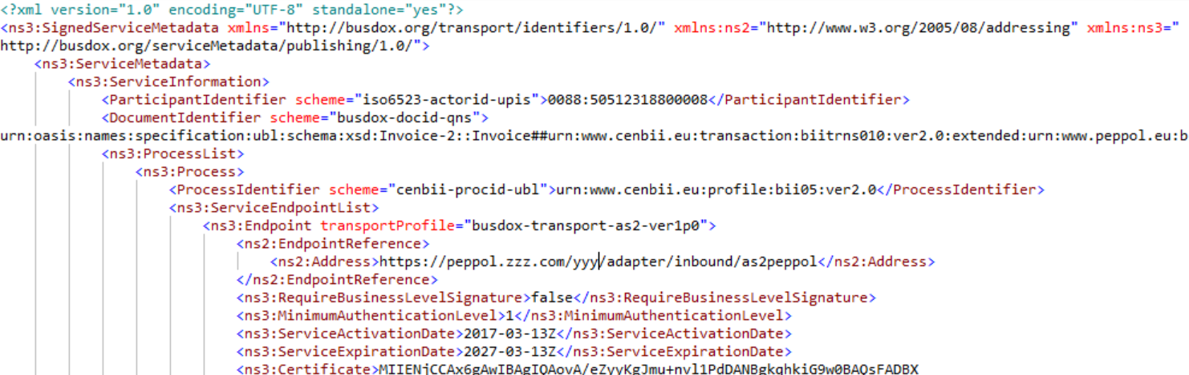
Service Metadata Example
The Participant’s identifier
Type of supported business message
Type of business process
Type of transport protocol to use for this message
Technical endpoint/address to where the message should be sent

Slide 27
Dynamic discovery in detail
Phase 2: Operations
SML
The role of the SML (Service Metadata Locator) is to manage the resource records of the participants and SMPs (Service Metadata Publisher) in the DNS (Domain Name System). The SML is usually a centralised component in an eDelivery Messaging Infrastructure.
SMP
Once the sender discovers the address of the receiver’s SMP, it is able to retrieve the needed information (i.e. metadata) about the receiver. With such information, the message can be sent. The SMP is usually a distributed component in an eDelivery Messaging Infrastructure.
Seller
Participant
C1
C4
Participant
Buyer
STEP 1. SUBMIT
ORIGINAL SENDER
FINAL RECIPIENT
SML
(centralised)
Access Point Provider
C2
C3
Access Point Provider
STEP 2. LOOKUP
DNS
Access
Point
SEND
STEP 4. SEND
RECEIVE
Access
Point
MESSAGE EXCHANGE PROTOCOL
ACKNOWLEDGE
Internet
SMP
SMP
STEP 3. RETRIEVE METADATA
1. Seller issues an eInvoice (or other eDocument) and hands it over to the AP
2. The AP makes a lookup using a HTTP GET. The DNS directs the AP to the participant’s SMP
3. The HTTP GET results in the service metadata for the end point (AP)
4. The AP sends the eInvoice to the receiver’s AP

Slide 28
Dynamic discovery in detail
Phase 2: Operations
SML
The role of the SML (Service Metadata Locator) is to manage the resource records of the participants and SMPs (Service Metadata Publisher) in the DNS (Domain Name System). The SML is usually a centralised component in an eDelivery Messaging Infrastructure.
SMP
Once the sender discovers the address of the receiver’s SMP, it is able to retrieve the needed information (i.e. metadata) about the receiver. With such information, the message can be sent. The SMP is usually a distributed component in an eDelivery Messaging Infrastructure.
Seller
Participant
C1
C4
Participant
Buyer
STEP 1. SUBMIT
STEP 5. DELIVER
ORIGINAL SENDER
FINAL RECIPIENT
SML
(centralised)
Access Point Provider
C2
C3
Access Point Provider
STEP 2. LOOKUP
DNS
Access
Point
SEND
STEP 4. SEND
RECEIVE
Access
Point
MESSAGE EXCHANGE PROTOCOL
ACKNOWLEDGE
Internet
SMP
SMP
STEP 3. RETRIEVE METADATA
1. Seller issues an eInvoice (or other eDocument) and hands it over to the AP
2. The AP makes a lookup using a HTTP GET. The DNS directs the AP to the participant’s SMP
3. The HTTP GET results in the service metadata for the end point (AP)
4. The AP sends the eInvoice to the receiver’s AP
5. The receiver’s AP hands the eInvoice over to the Buyer

Slide 29
Scalability of the infrastructure
4

Slide 30
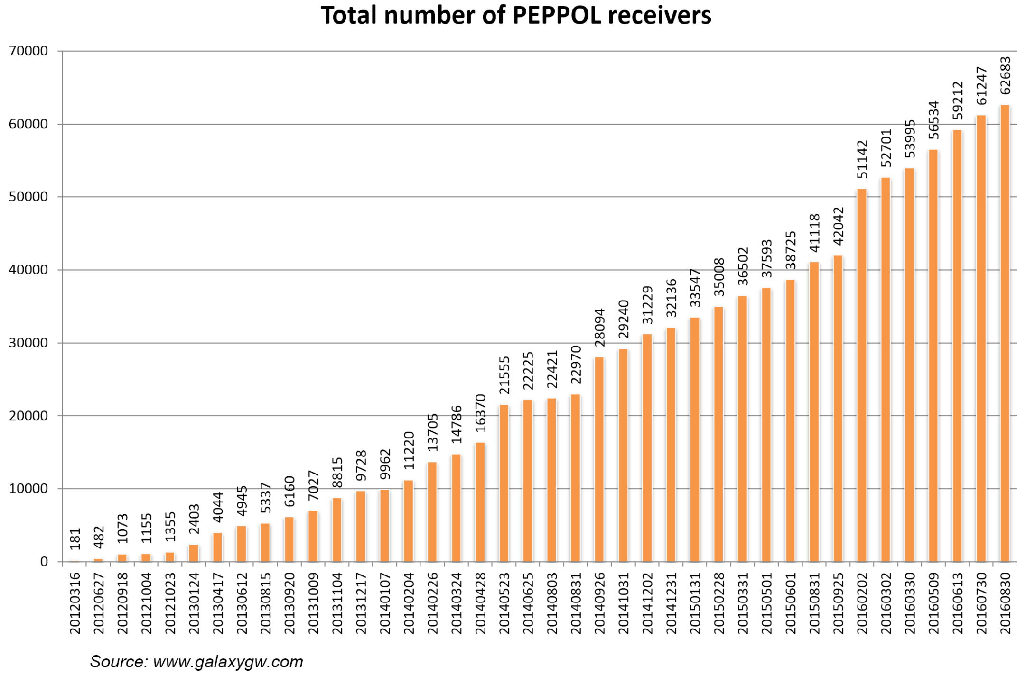
Scalability of the infrastructure
Total number of organizations capable of receiving eInvoices in PEPPOL
The discovery mechanism is using DNS, well known for stability and performance
The only central service, the SML, is for administration of the participants, not the message flow itself
2017 Q1: 85.000 registered receivers!
2017 Q3: 100.000 registered receivers!

Slide 31


CEF eDelivery is not a one-size fits all solution
EXCHANGE MODEL | TOPOLOGY | 4-corner model | 4-corner model | Your choice
 | PROTOCOL | PEPPOL AS2 profile | e-SENS AS4 profile | e-SENS AS4 profile recommended
 | INTEGRATION APPROACH | Service Providers (Market) | Specific Connector | Your choice
DISCOVERY MODEL |  | Dynamic | Static | Your choice
SECURITY MODEL | TRUST CIRCLE | PKI | Mutual trust | Your choice
 | SECURITY CONTROL | Liberal inner security | Inner security with connector | Your choice
Your CEF eDelivery implementation
SCOPE OF CEF eDELIVERY

Slide 32
Summary
Automatic discovery is necessary for mass-use of electronic business
A common collaboration agreement and security structure
The service metadata contains all you need to know to dynamically connect and exchange messages
Necessary to implement routines for handling new business partners
No roaming fees or discrimination of participants allowed
Standardised specification

Slide 33
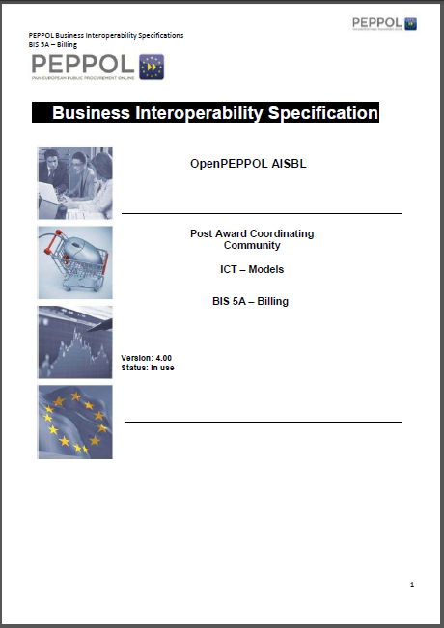
What can be transmitted in the network?
PEPPOL BIS conformant messages
  Implementation guides of CEN standards
  Adds policy for identifiers and further restrictions
  Also other messages can be exchanged, but BIS is a minimum requirement to be registered in the SML (Baseline interoperability)

Slide 34
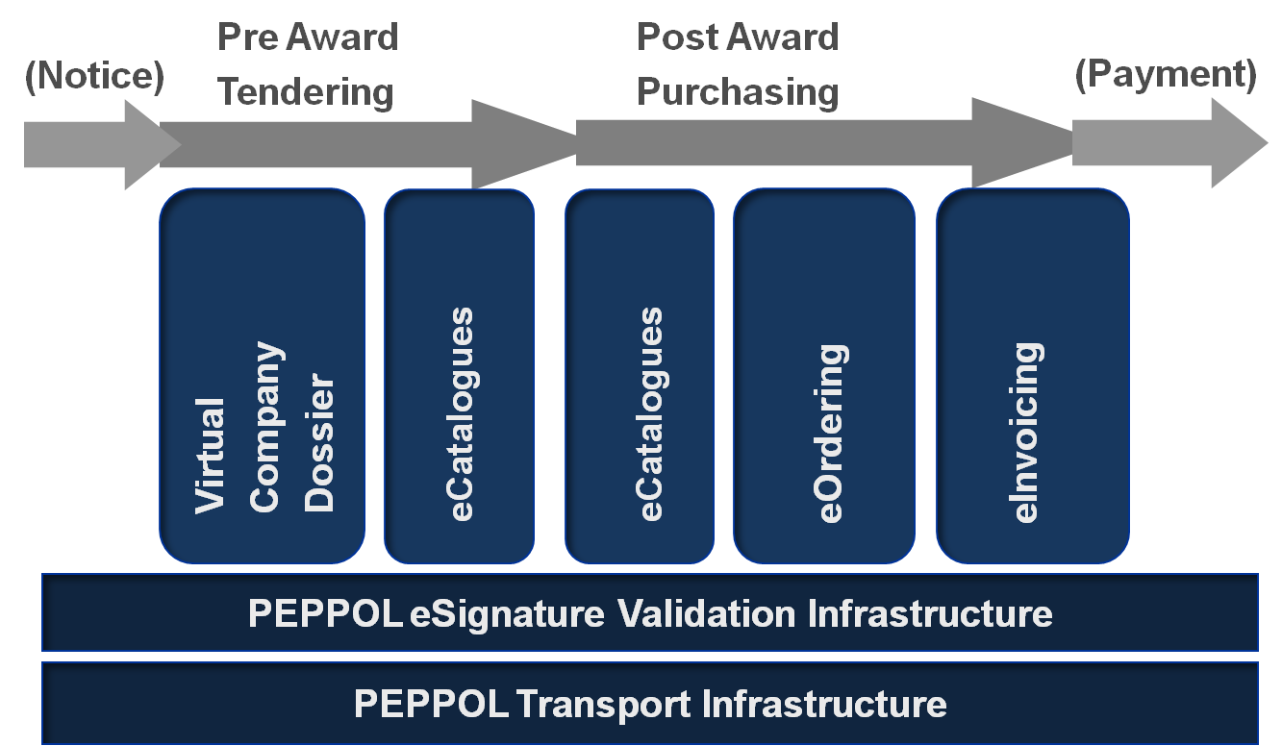
eProcurement

Slide 35
Current BIS
Despatch Advice 30A
Invoice 4A
Ordering 28A
Catalogue 1A
Billing 5A
Order Only 3A
Message Level Response 36A
Punch Out 18A
Order Agreement 42A
Invoice Message Response (ongoing)
Notes:
SÖREN

Slide 36
European Core eInvoice Standard

Slide 37
Background
Problems with many standards
Lack of normative contextualised standards (only workshop agreements)
Different approaches and ambitions in Member States to implementing eInvoicing and eProcurement
The Directive on electronic invoicing in public procurement (Directive 2014/55/EU) was developed, setting a minimum requirement for the public sector
From the Directive
The benefits of electronic invoicing are maximised when the generation, sending, transmission, reception and processing of an invoice can be fully automated.
…
A mere image file should not be considered to be an electronic invoice for the purpose of this Directive.
Notes:
(Whereas 7) The benefits of electronic invoicing are maximised when the generation, sending, transmission, reception and processing of an invoice can be fully automated. For this reason, only machine-readable invoices which can be processed automatically and digitally by the recipient should be considered to be compliant with the European standard on electronic invoicing. A mere image file should not be considered to be an electronic invoice for the purpose of this Directive.

Slide 38
Requirements for the contracting authorities/entities
From article 7
Receipt and processing of electronic invoices
Member States shall ensure that contracting authorities and contracting entities receive and process electronic invoices which comply with the European standard on electronic invoicing whose reference has been published pursuant to Article 3(2) and with any of the syntaxes on the list published pursuant to Article 3(2).
a list with a limited number of syntaxes which comply with the European standard on electronic invoicing
Semantic data model of the core elements of an electronic invoice

Slide 39
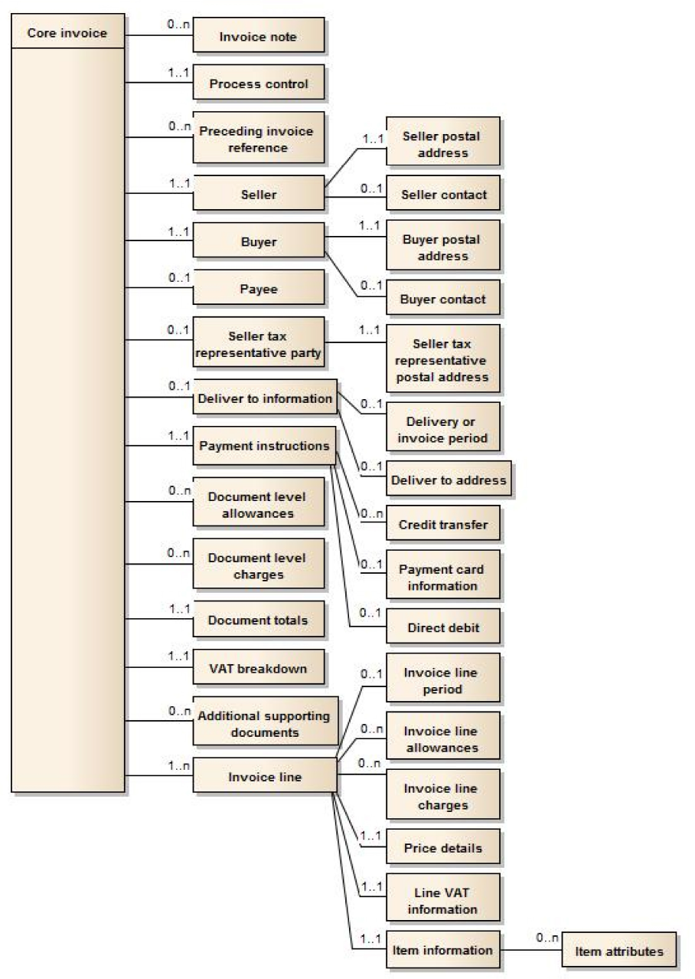
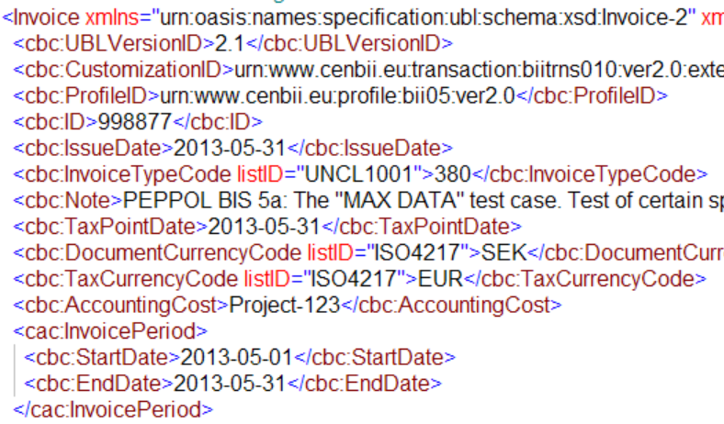
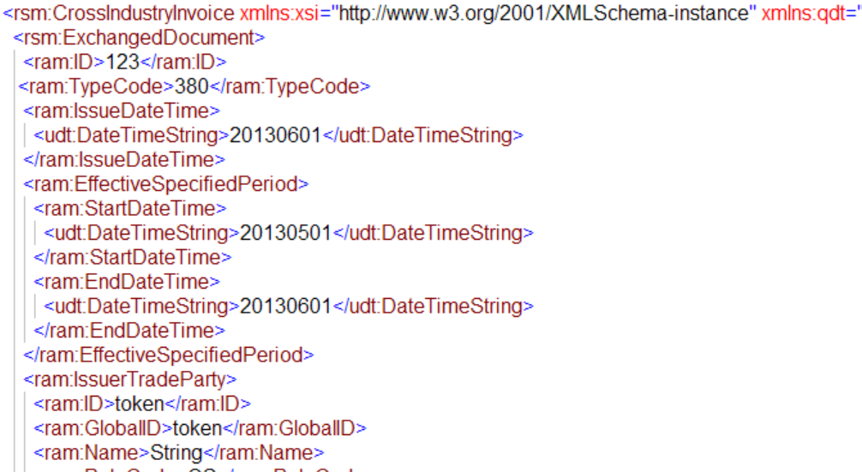
Definitions
Issued, transmitted and received in a
structured electronic format
Seller’s IT-solution
Buyer’s IT-solution
(1) ‘electronic invoice’ means an invoice that has been issued, transmitted and received in a structured electronic format which allows for its automatic and electronic processing;
(2) ‘core elements of an electronic invoice’ means a set of essential information components which an electronic invoice must contain in order to enable cross-border interoperability, including the necessary information to ensure legal compliance;
(3) ‘semantic data model’ means a structured and logically interrelated set of terms and their meanings that specify the core elements of an electronic invoice;
(4) ‘syntax’ means the machine readable language or dialect used to represent the data elements contained in an electronic invoice;
(5) ‘syntax bindings’ means guidelines on how a semantic data model for an electronic invoice could be represented in the various syntaxes;
Syntax bindings
Syntax A
Semantic data model of
the core elements
(Business terms and rules)
Syntax B

Slide 40

Section 1-3 - Scope, references, terms & definitions
Section 4 – The concept of a core invoice
Section 5 – Business process to support
Section 6 – The semantic model, rules and data types
Section 7 – Core Invoice Usage Specification (and
compliance)
___________________________________________
Annex A – Examples (Informative)
Annex B – Assessment of the EN towards the
Standardization request (Informative)
Annex C – How does the EN meet legal
requirements (Informative)
Annex D – BPMN symbols (informative)
© CEN, reproduced with permission

Slide 41
The semantic model
Examples of key components
Invoice (header)
Invoice number (1..1)
Issue date (1.1)
Type code (1..1)
Currency code (1..1)
….
Seller information
Name (1..1)
Trading name (0..1)
Identifier (0..n)
Legal registration identifier (0..1)
VAT number (0..1)
Additional legal info (0..1)
…
Payment instructions
Payment means type code (1..1)
Payment means text (0..1)
Remittance info (0..1)
…
VAT Breakdown
Category taxable amount (1..1)
Category tax amount (1..1)
Category code (1..1)
Category rate (0..1)
Exemption text (0..1)
Exemption code (0..1)
Item information
Name (1..1)
Description (0..1)
Sellers identifier (0..1)
Buyers identifier (0..1)
Standard identifier (0..1)
Item classification (0..n)
Country of origin (0..1)
EN 16931-1:2017 Chapter 6.1
© CEN, reproduced with permission

