Slide 1
Belgian Peppol Service Providers Forum
32nd edition
14.11.2023
BOSA-SDVD

Slide 2
Welcome

Slide 3
Agenda
smp.belgium.be retirement
Rejection on AS4 level
eInvoicing testimonials
Your questions & topics
Backlog / AOB / Next forum

Slide 4
Agenda
smp.belgium.be retirement
Rejection on AS4 level
eInvoicing testimonials
Your questions & topics
Backlog / AOB / Next forum

Slide 5
smp.belgium.be: reminder of the retirement process
Step 1: initiate planning at SPs
Last SP forum we kindly asked you to communicate the availability date of your move away plan
To date we received
No answer to the question (probably it was not clear enough)
3 move-away plans
3 confirmation that smp.belgium.be is not used / not used anymore
Step 2: gather SP planning → determine phase out date and possible coordination actions
Please communicate your move away plan by 14/07/2023
On 15/7/2023 BOSA will set a phase out date based on the information received
Please communicate your plans by then.
Based on this information BOSA will figure out and communicate appropriate support/coordination/follow-up plan.
Step 3: follow up the execution of the SPs move-away from smp.belgium.be
Step 4: debrief the move-away operation and remove smp.belgium.be from service
smp.belgium.be retires on 31.12.2023

Slide 6
smp.belgium.be: material
Shared information by Service Providers
Service Providers owning/having entries in smp.belgium.be received on 31.7 their part of the list of entries with receiving capabilities.
Thanks to the ones that did react and confirmed.
For the others, thanks to confirm you are on it.
We will share again an updated version of your recorded entries in the week of November 20th
Please do finalise your migration by December 1st

Slide 7
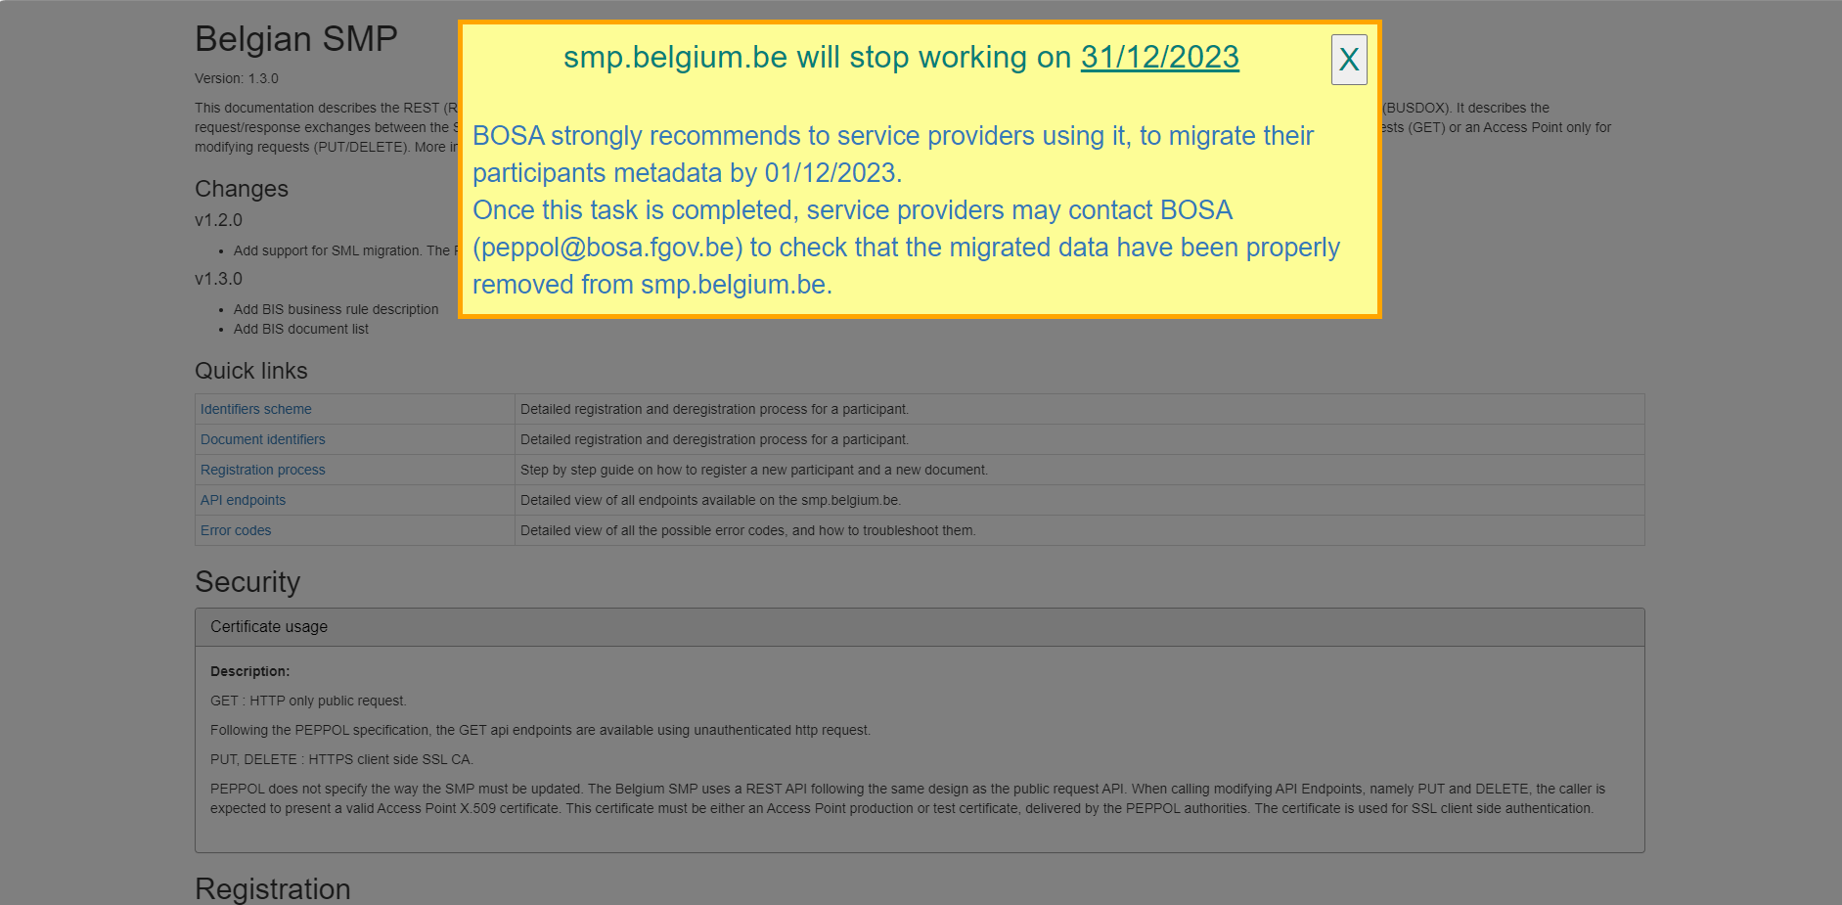
smp.belgium.be: visual
Belgian SMP (belgium.be)

Slide 8
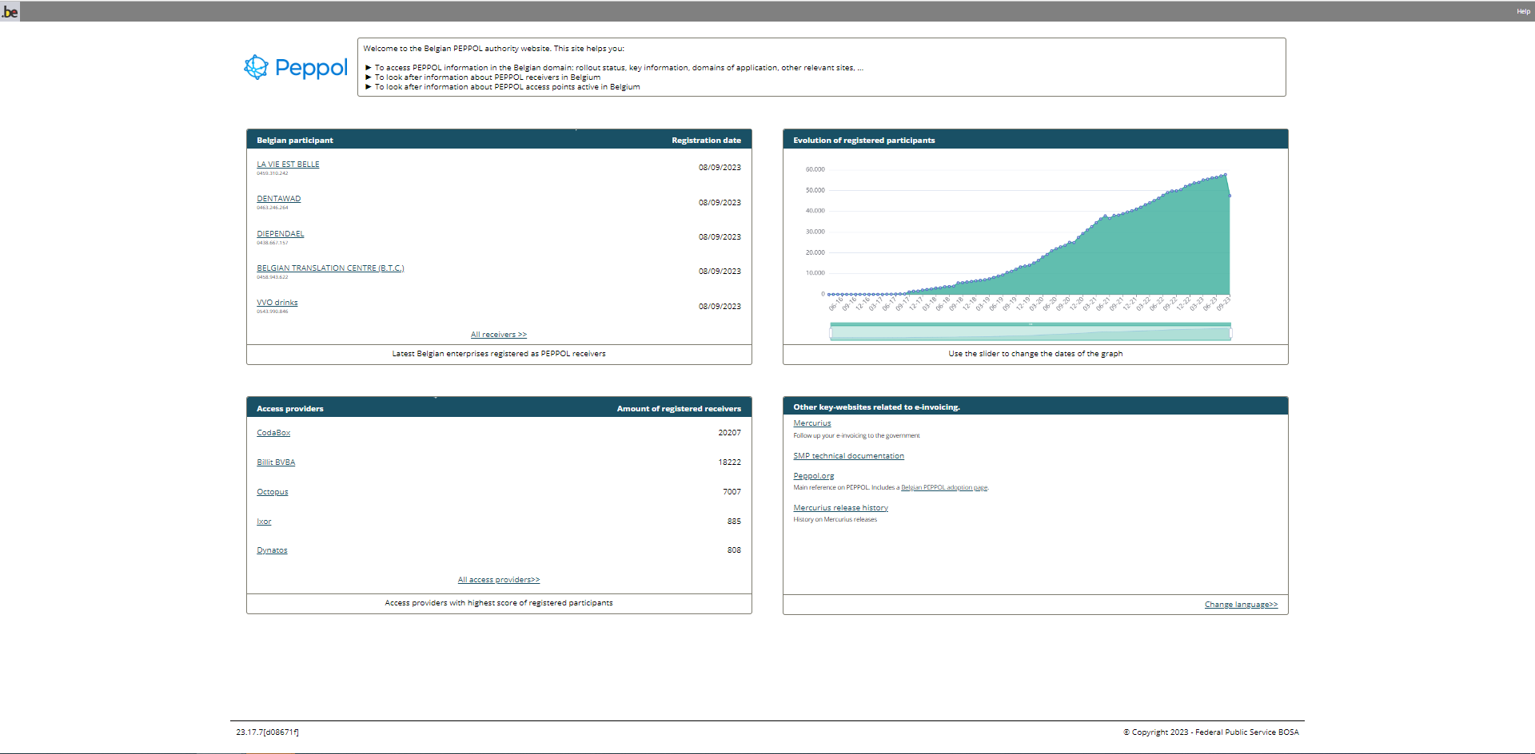
Peppol in Belgium: removal
Information message provided
Due to the upcoming retirement of smp.belgium.be, this page has become obsolete.
An overlay appears on the page.
The overlay contains a message and display useful links towards:
Peppol (Directory, Certified Service Providers lists, the Belgium page)
The e-Invoice page containing the list of IT Solution providers in Belgium

Slide 9
Peppol in Belgium: visual
PEPPOL (belgium.be)

Slide 10
Agenda
smp.belgium.be retirement
Rejection on AS4 level
eInvoicing testimonials
Your questions & topics
Backlog / AOB / Next forum

Slide 11
Rejection on AS4 level
14 Nov 2023
Version 1.0 - 14 Nov 2023

Slide 12
Agenda
Context
Proposed solution
Open discussion

Slide 13
01
Context

Slide 14
Context
Peppol Rule :
As a sending Peppol Service provider, you must ensure that the business documents sent from your customers are confirmed as valid instances, according to the applicable rules, before accepting them for transport through your Access Point services, either by providing validation services on behalf of your customers, or by ensuring that your customers have performed such validation on their Peppol BIS documents
Extract from How to set up a (Post-Award procurement) Peppol Access Point (AP) v1.9
Answering on errors with MLR not always possible
Creates burden on Receiver shoulders
MLS (Message Level Status) currently being formalized (release date TBC)

Slide 15
02
Proposed solution

Slide 16
Input by P. Helger from OpenPeppol (support ticket)
The sole usage of MLR does not solve the problem, but it is part of the solution.
The current optimal process in this regard is as follows:
You validate synchronously and found at least one Error
You synchronously check if the sender supports MLR or not (via SMP call)
Case a) sender supports MLR
Send a positive AS4 Receipt back
Create the MLR and trigger an explicit AS4 transmission of the MLR
Note: make sure the AS4 Receipt is received by the sender BEFORE the MLR is send (asynchronous processing required)
Case b) sender does not support MLR
Send back an AS4 Error with the error details
Note: do not use SOAP Faults but an AS4 SignalMessage with an Error element inside

Slide 17
Short term solution
Goal is not to replace the MLS Solution being developed by OpenPeppol
Provide a quick short-term solution to leverage burden on Receivers’ shoulders in awaiting the MLS delivery (interim solution)

Slide 18
03
Open discussion

Slide 19
Open discussion
Goal of the presentation is to have an open discussion about this topic
Pros/cons?
Feasibility? Constraints?
Thanks for your input

Slide 20
Agenda
smp.belgium.be retirement
Rejection on AS4 level
eInvoicing testimonials
Your questions & topics
Backlog / AOB / Next forum

Slide 21
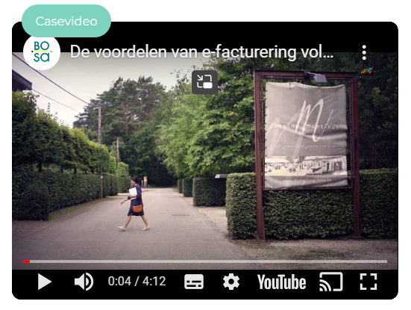
eInvoicing testimonials
We are looking for additional relevant and interesting testimonials.
In case you are interested contact us via the Contact form or send an e-mail to e-invoicing@bosa.fgov.be

Slide 22
Agenda
smp.belgium.be retirement
Rejection on AS4 level
eInvoicing testimonials
Your questions & topics
Backlog / AOB / Next forum

Slide 23
Your questions – topics
No questions received from participants

Slide 24
Agenda
smp.belgium.be retirement
Rejection on AS4 level
eInvoicing testimonials
Your questions & topics
Backlog / AOB / Next forum

Slide 25
AOB / Next forum
Next forum: 16.1.2024
PASR -> update to come. Always have the 0208!
itsme connection for Mercurius Portal is available

Slide 26
Thanks for your attendance!

Slide 27
Backlog
# | Topic | Status | Comments
1 | CTC | Backlog | Depends on B2B progress.
2 | Planning for B2B obligations in BE | Ongoing | 1st presentation done by FPS Finance 22.11.22 2nd presentation done by FPS Finance 27.06.23
3 | B2C agenda | Backlog | Long term
4 | SP ISO Certification | Done | Was already considered: confer notes of forum of 21-03-2023 Update 27-06-2023: workgroup delivered final report. Next phase is to develop the specifications and establish governance bodies. Expect medium term update

Slide 28
Wrap up
Confer https://openpeppol.atlassian.net/wiki/spaces/Belgium/overview

