Slide 1
Belgian Peppol Service Providers Forum
31st edition
12.09.2023
BOSA-DT

Slide 2
Welcome

Slide 3
Agenda
smp.belgium.be retirement
Your questions & topics
Backlog / AOB / Next forum

Slide 4
Agenda
smp.belgium.be retirement
Your questions & topics
Backlog / AOB / Next forum

Slide 5
smp.belgium.be: the retirement process
Step 1: initiate planning at SPs
Last SP forum we kindly asked you to communicate the availability date of your move away plan
To date we received
No answer to the question (probably it was not clear enough)
3 move-away plans
3 confirmation that smp.belgium.be is not used / not used anymore
Step 2: gather SP planning → determine phase out date and possible coordination actions
Please communicate your move away plan by 14/07/2023
On 15/7/2023 BOSA will set a phase out date based on the information received
Please communicate your plans by then.
Based on this information BOSA will figure out and communicate appropriate support/coordination/follow-up plan.
Step 3: follow up the execution of the SPs move-away from smp.belgium.be
Step 4: debrief the move-away operation and remove smp.belgium.be from service

Slide 6
smp.belgium.be: retirement date
smp.belgium.be retires on 31.12.2023

Slide 7
smp.belgium.be: material
Shared information by Service Providers
Service Providers owning/having entries in smp.belgium.be received on 31.7 their part of the list of entries with receiving capabilities.
Thanks to the ones that did react and confirmed. For the others, thanks to confirm you are on it.

Slide 8
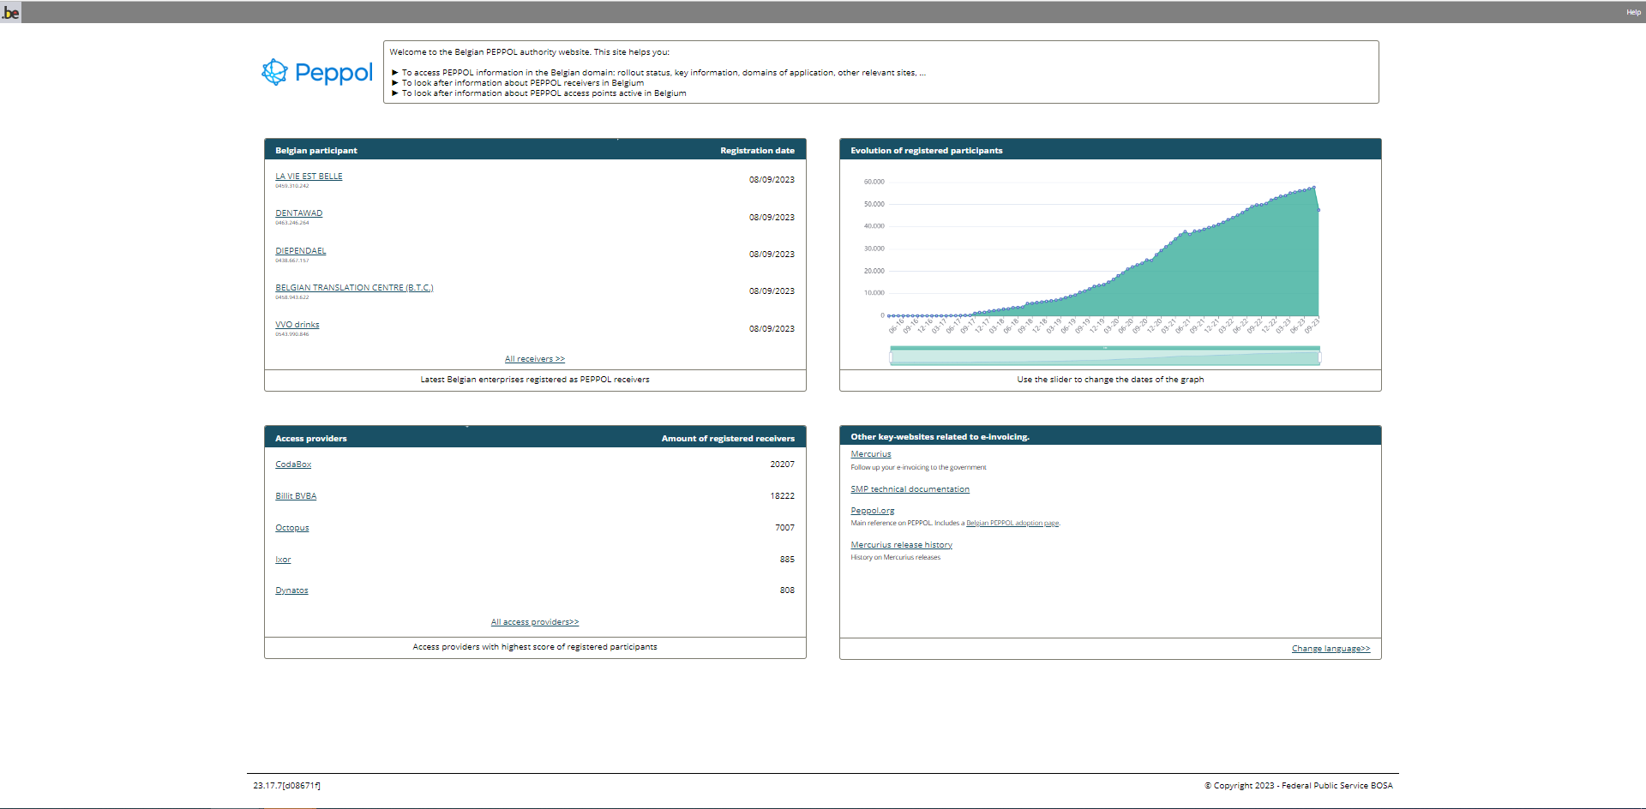
smp.belgium.be: visual
Update of the Peppol page?
Analysis is ongoing, once the page is updated you’ll be informed.

Slide 9
Agenda
smp.belgium.be retirement
Your questions & topics
Backlog / AOB / Next forum

Slide 10
Your questions – topics
Migrating from Hermes must go first to smp.belgium.be and can afterwards be migrated to other smp. Is this something that can be improved?
MTCI
Evolution of registered participants on PEPPOL (belgium.be)
Answer given in previous topic
Communication BOSA on B2G becoming mandatory sending – 1/3/2024 instead of 1/11/2023? Link to legislation?
Press conference 11.9.2023 mentioning 1.3.2024

Slide 11
Agenda
smp.belgium.be retirement
Your questions & topics
Backlog / AOB / Next forum

Slide 12
AOB / Next forum
Next forum: 14.11.2023
Your topics?
9956 REMOVAL 123123 published in latest code list (v8.6) NB: was already presented by eDEC at SPC20230822, slide 4

Slide 13
Backlog
# | Topic | Status | Comments
1 | CTC | Backlog | Depends on B2B progress.
2 | Planning for B2B obligations in BE | Ongoing | 1st presentation done by FPS Finance 22.11.22 2nd presentation done by FPS Finance 27.6.23
3 | B2C agenda | Backlog | Long term
4 | SP ISO Certification | Done | Was already considered: confer notes of forum of 21-03-2023 Update 27-06-2023: workgroup delivered final report. Next phase is to develop the specifications and establish governance bodies. Expect medium term update

Slide 14
Thanks for your attendance!

Slide 15
Wrap up
Confer https://openpeppol.atlassian.net/wiki/spaces/Belgium/overview

