Slide 1

Belgian Peppol Service Providers Forum
30th edition
27.06.2023
BOSA-DT

Slide 2
Welcome

Slide 3

Agenda
National developments in B2B eInvoicing by FPS Finance
SchemeID 9956 (& old MLR DocType) removal
smp.belgium.be retirement
MTCI
Backlog / AOB / Next forum

Slide 4
Agenda
National developments in B2B eInvoicing by FPS Finance
SchemeID 9956 (& old MLR DocType) removal
smp.belgium.be retirement
MTCI
Backlog / AOB / Next forum

Slide 5
E-invoicing / e-Reporting
B2B

Slide 6
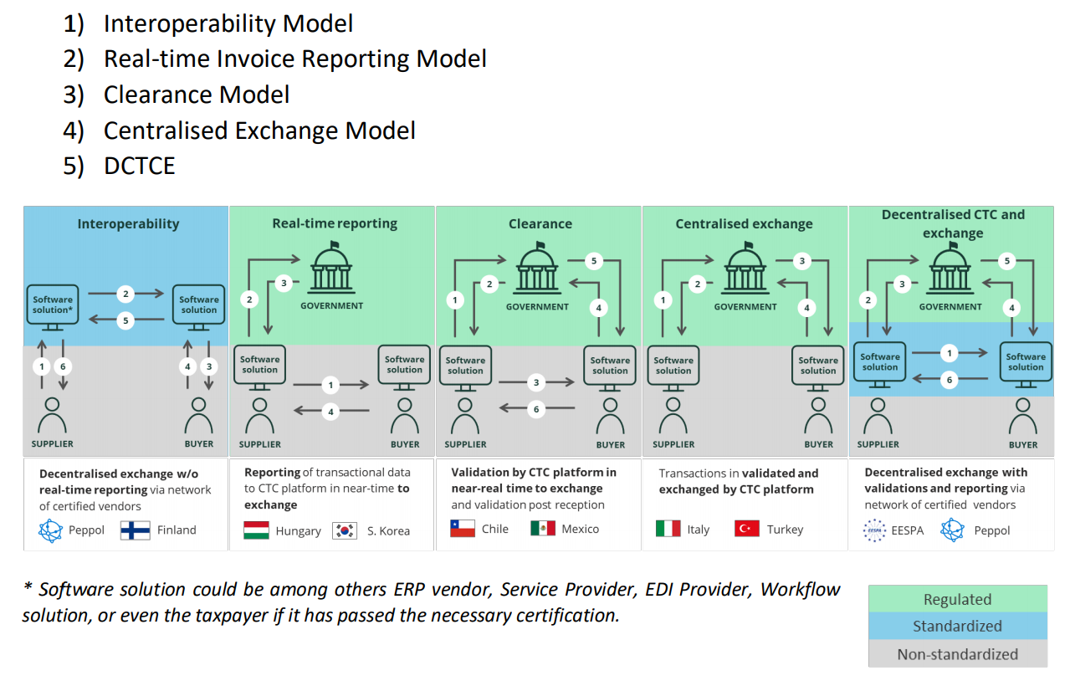
E-invoicing and E-REPORTING models
Phase 1
Phase 2
Source: https://eespa.eu/a-next-generation-model-for-electronic-tax-reporting-and-invoicing/

Slide 7

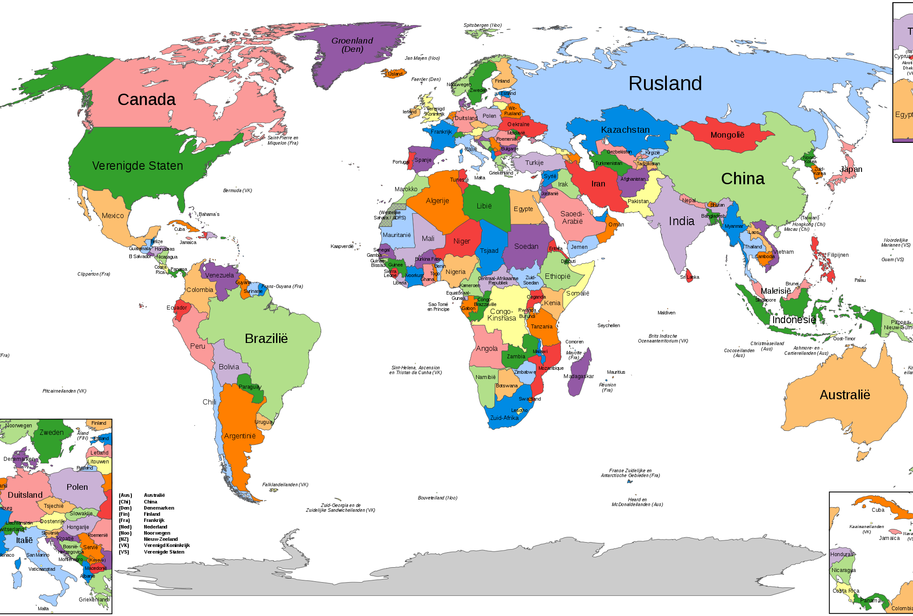
Extreme scenario’s
Only 1 format and 1 network
Every country it’s own format and network

Slide 8

Belgium plans on e-invoicing
Dual-Track approach
First track: standard – Peppol – Common Denominator Framework (format + transmission + organisation + legal + governance)
Second track: opt-out upon mutual agreement if both parties agree the common denominator doesn’t fulfil business needs or to protect investments made
1
2

Slide 9
Status
Draft legislation has been discussed with national stakeholders
No implementation timeline can be communicated, as this will depend on the timing of the parliamentary process

Slide 10
Agenda
National developments in B2B eInvoicing by FPS Finance
SchemeID 9956 (& old MLR DocType) removal
smp.belgium.be retirement
MTCI
Backlog / AOB / Next forum

Slide 11
SchemeID 9956 (incl. old MLR DocType) REMOVAL
Removal of 9956 schemeID from eDEC list of identifiers:
  9956 Is deprecated since end 2021.
  9956 Removal date :
31/12/2023
(next codelist publication: date to be announced)
eDEC procedures include the practicals to ensure clean and complete removal (over the whole network).
BOSA aligns with eDEC to make sure that the messages and efforts are consistent.
We provided the concerned SP’s their list of to be cleaned entries (27/1 > 20/3 > 13/4 > 4/5 > 9/6)
Figures dropped significantly. Thanks!
Now we would like to close. Do you need more help?
SP’s are contractually obliged to ensure that “rubbish” is duly cleaned up (compliance)

Slide 12
Old MLR decommissioning
SPs need to ensure that such receiving capabilities are removed

Slide 13
9956 decommissioning
SPs need to ensure 9956 are (re)moved.

Slide 14
Agenda
National developments in B2B eInvoicing by FPS Finance
SchemeID 9956 (& old MLR DocType) removal
smp.belgium.be retirement
MTCI
Backlog / AOB / Next forum

Slide 15
smp.belgium.be retires – the process
Step 1: initiate planning at SPs
Last SP forum we kindly asked you to communicate the availability date of your move away plan
To date we received
  No answer to the question (probably it was not clear enough)
  3 move-away plans
  3 confirmation that smp.belgium.be is not used / not used anymore
Step 2: gather SP planning → determine phase out date and possible coordination actions
Please communicate your move away plan by 14/07/2023
On 15/7/2023 BOSA will set a phase out date based on the information received
Please communicate your plans by then.
Based on this information BOSA will figure out and communicate appropriate support/coordination/follow-up plan.
Step 3: follow up the execution of the SPs move-away from smp.belgium.be
Step 4: debrief the move-away operation and remove smp.belgium.be from service

Slide 16
Agenda
National developments in B2B eInvoicing by FPS Finance
SchemeID 9956 (& old MLR DocType) removal
smp.belgium.be retirement
MTCI
Backlog / AOB / Next forum

Slide 17
MTCI (Migration Token Collection Interface)
Information is to be found on: https://openpeppol.atlassian.net/wiki/spaces/Belgium/pages/1111883917/Belgian+Service+Providers+Access+Point+Forum+confluence#Testing-data---practical-aspects
You still need to test MTCI?
Drop a mail to peppol@bosa.fgov.be and we’ll provide you with a dataset!

Slide 18
Agenda
National developments in B2B eInvoicing by FPS Finance
SchemeID 9956 (& old MLR DocType) removal
smp.belgium.be retirement
MTCI
Backlog / AOB / Next forum

Slide 19
AOB / Next forum
Next forum: 12.09.2023
Your topics?

Slide 20
Backlog
# | Topic | Status | Comments
1 | CTC | Backlog | Depends on B2B progress.
2 | Planning for B2B obligations in BE | Ongoing | 1st presentation done by FPS Finance 22.11.22 2nd presentation done by FPS Finance 27.6.23
3 | B2C agenda | Backlog | Long term
4 | SP ISO Certification | Done | Was already considered: confer notes of forum of 21-03-2023 Update 27-06-2023: workgroup delivered final report. Next phase is to develop the specifications and establish governance bodies. Expect medium term update

Slide 21
Thanks for your attendance!

Slide 22
Wrap up
Confer https://openpeppol.atlassian.net/wiki/spaces/Belgium/overview

