Slide 1
Belgian Peppol Service Providers Forum
27th edition
17.01.2023
BOSA-DT

Slide 2
Welcome

Slide 3
Our best wishes to you and your beloved ones

Slide 4
Agenda
Hermes Agreement Framework
Removal of 9956 schemeID from eDEC list of identifiers
Backlog / AOB / Next forum

Slide 5
Agenda
Hermes Agreement Framework
Removal of 9956 schemeID from eDEC list of identifiers
Backlog / AOB / Next forum

Slide 6
Hermes Agreement Framework
# | summarized description | response
1 | Lang Attribute unsupported. Suggests to make Language property mandatory at sender's onboarding | Possible lack of clarity in the specs, clause 7 and 8; such change could impair other senders / SPs having a different needs / contexts (example: make invoice language receiver-dependent)
2 | how does it fit with a busienss model where the SP "sorts it out for his customer"? | the agreement leaves freedom to the SP as how to deal with the customer side, insofar the legislation, in the context of Hermes, does not explicitly require the customer to (a) be aware and consenting and (b) be responsible (for instance, for informing the receiver and opting him out in case he does not agree with the use of Hermes)
3 | the agreement is not sufficient to meet GDPR. A specific "DataProcessingAgreement" is required. | communicated to Legal. Won't be changed unless Legal gives such feedback and directions
4 | consent is not suitable lawful basis for using Hermes | communicated to Legal. Won't be changed unless Legal gives such feedback and directions
5 | unauthorized access is not referenced | communicated to Legal. Won't be changed unless Legal gives such feedback and directions
6 | SP sees no need to quarterly report senders (IO-CI section 6 paragraph 4) | it is needed for a posteriori control of the flows, that is required because of the white-listing strategy implemented.
7 | clarify clause related to required capacity (IO-CI section 6 paragraph 5); is it about volumes? | keeping system capacity in line with the usage growth, typically requires tracking volume growth. Additionally, in some case, other parameters can play a major role and can be reported on an adhoc basis.
8 | clarify audit trail 10-years retention | 10-years is BOSA typical horizon for audit trail. It is not related to invoice archiving. It is also not about the invoice data. Only the audit trail data
9 | clarify audit trail responsibilities | each system owner maintains his own audit trail data, so that the complete chain can always be reconstructed.
10 | balance of risks between parties | in the agreement BOSA describes the service and the derived responsibilities that BOSA can and cannot take. It is then up to the SP to further balance the risks with their customers. BOSA believes that such a fair balance can be achived in the vast majority of cases.
11 | balance in termination terms | neither senders nor SPs have obligation to notify termination or update in advance. Only BOSA has such obligation.
12 | SP cannot understand why SP must warrant to include Hermes Ts&Cs with SP Ts&Cs. | because BOSA (a) has no relation with the senders, and (b) needs that the senders’ responsibilities are understood by the sender. How the SP proceeds with such inclusion, is the prerogative of the SP.
13 | avoid vague language, specify time-frame for termination notice. | is done to the best of BOSA's abilities. Can certainly be improved further in due time
14 | shippers … shippers (twice) | corrected. Was a translation problem
15 | language. Issue an EN version | BOSA takes note of the request. On the other hand, BOSA stresses that this is a Belgian initiative, so SPs present in Belgium are supposed to be able to use FR or NL.

Slide 7
Hermes Agreement Framework
Next: BOSA to publish V2 (in the coming weeks) and request resigning

Slide 8
Agenda
Hermes Agreement Framework
Removal of 9956 schemeID from eDEC list of identifiers
Backlog / AOB / Next forum

Slide 9
Removal of 9956 schemeID from eDEC list of identifiers
Removal of 9956 schemeID from eDEC list of identifiers
Decommissioning by next release.
Removal by next release +1
Last use case for this schemeID: Old MLR – cf next slide

Slide 10
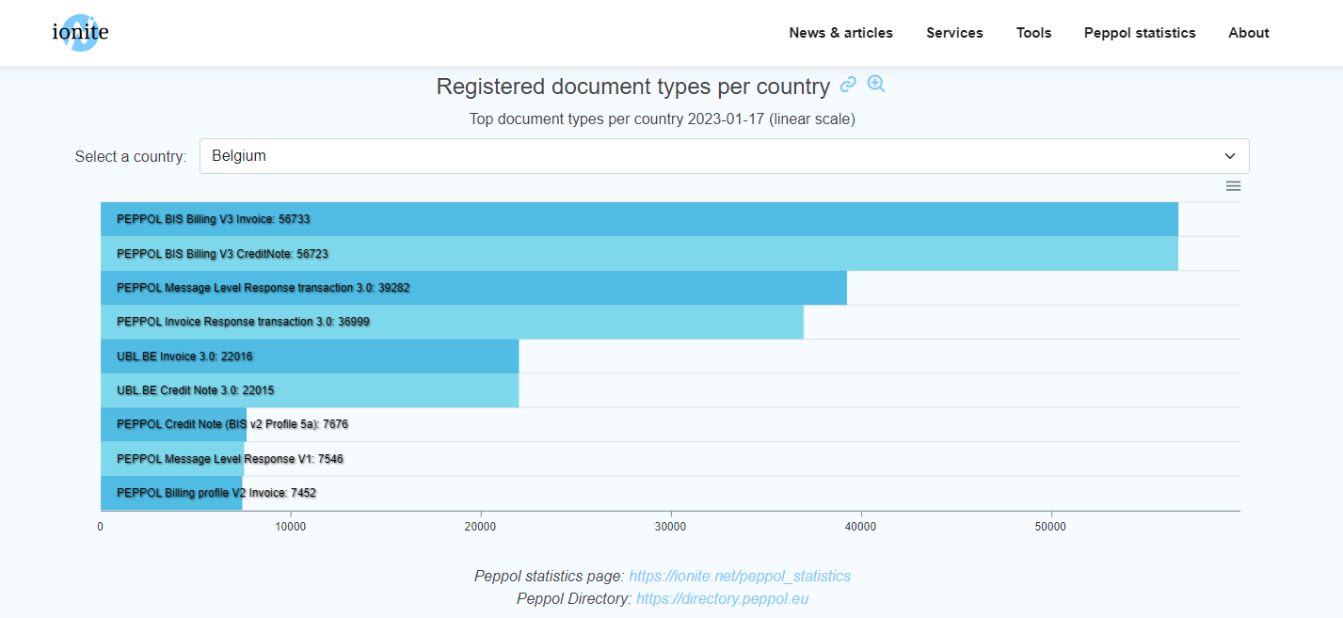
An overview https://ionite.net/peppol_statistics/

Slide 11
What’s Next?
SPs need to ensure that such receiving capabilities are removed.
To the SPs concerned PA will send a document with :
registered participants that still have the old MLR receiving capability.

Slide 12
What else?
As for MLR capability, we found some old AS2 related information (endpoint in AS2).

Slide 13
Agenda
Hermes Agreement Framework
Removal of 9956 schemeID from eDEC list of identifiers
Backlog / AOB / Next forum

Slide 14
AOB / Next forum
Next forum: 21.03.2023
Your topics?

Slide 15
Thanks for your attendance!

Slide 16
Wrap up

