Slide 1
Belgian Peppol Service Providers Forum
26th edition
22.11.2022
BOSA-DT

Slide 2
Welcome

Slide 3
Agenda
B2B update by FPS Finance
Feedback F2F meetings 11.2022
Hermes Agreement Update
Backlog / AOB / Next forum

Slide 4
Agenda
B2B update by FPS Finance
Feedback F2F meetings 11.2022
Hermes Agreement Update
Backlog / AOB / Next forum

Slide 5
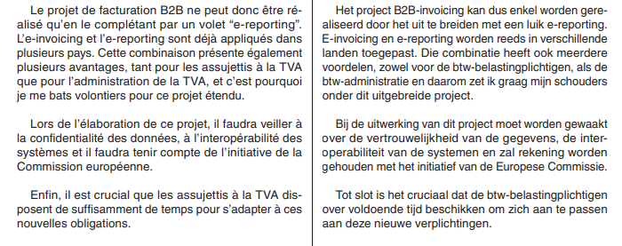
STAVAZA
Standpunt Europese Commissie: E-Reporting is vereist om E-Invoicing te kunnen verplichten (afwijking Europese btw richtlijn);
Beleidsnota Financiën 2023: blz 14-15 :
De Europese Commissie zal op 7/12 een voorstel publiceren rond DRR (Digital Reporting Requirements), als onderdeel van het initiatief “VAT in the digital age” (VAT reporting obligations and e-invoicing)

Slide 6
E-invoicing and E-REPORTING models
Source: https://eespa.eu/a-next-generation-model-for-electronic-tax-reporting-and-invoicing/

Slide 7
Doel e-reporting
Administratieve vereenvoudiging: voor ondernemingen vervangt deze rapportering, de verplichting om een jaarlijkse klantenlisting in te dienen. E-reporting verloopt automatisch (koppeling aan e-invoicing).
Verminderen VAT Gap: e-reporting verkleint de kans dat partijen voor eenzelfde transactie verschillende bedragen opnemen in hun aangifte (te weinig verschuldigde btw, of te veel aftrekbare btw).
Economische meerwaarde: realtime inzicht in een groot deel van de Belgische (binnenlandse) economie, wat veel betere analyses en dus gerichter beleid toelaat op macroniveau (denk aan analyses NBB, Planbureau, FOD Economie, FOD Fin inzake nieuwe fiscale wetgeving, steunmaatregelen in tijden van crisis, etc.).

Slide 9
Agenda
B2B update by FPS Finance
Feedback F2F meetings 11.2022
Hermes Agreement Update
Backlog / AOB / Next forum

Slide 10
Feedback F2F meetings 11.2022
Highlights on F2F meetings:
Update on figures
18 PA’s
500 Members
Used in 42 countries
EU was represented
EESPA was represented
? Int’l vs local
B2B vs Public Procurement
Call for action

Slide 11
Feedback F2F meetings 11.2022
Highlights on Technical part:
PINT
eDelivery update
Post-Award November Release
Testbed 2.0 Beta available for review

Slide 12
Agenda
B2B update by FPS Finance
Feedback F2F meetings 11.2022
Hermes Agreement Update
Backlog / AOB / Next forum

Slide 13
Hermes Agreement Update
Cf mail from BOSA 16.11.2022
Agreement V1 was MVP
Agreement V2 is first mature version
Main change: alignment with the Peppol agreements (de-duplication)
Also: advanced validation by Legal, incl. receiver’s impact
Composition:
IO – CI : Integrator's agreement
GV – CU: Terms of use
PV – DC: Privacy statement
Cookie Policy
FTVR – DFTS: Functional, Technical and Security guidelines

Slide 14
Hermes Agreement Update
Current: Release Candidate
Request: provide us your comments. Formalism:
send by email, by your main contact for this subject, to peppol@bosa.fgov.be;
Provide a description and a clear reference to the specific clause (unless general comment)
Assess importance (blocking, high, medium, low)
Provide suggestion to address the comment
Deadline for comments: proposal: 16/12/2022
Next:
BOSA will process comments. Default approach is to include comments in backlog for upcoming release
V2 will be released early 2023.

Slide 15
Hermes Agreement Update
Many thanks for your effort to contribute to the quality of this framework

Slide 16
Agenda
B2B update by FPS Finance
Feedback F2F meetings 11.2022
Hermes Agreement Update
Backlog / AOB / Next forum

Slide 17
AOB / Next forum
Next forum: 17.01.2023
MLR BISv2 has been decommissioned
Your topics?

Slide 18
Thanks for your attendance!

Slide 19
Wrap up

