Slide 1
Belgian Peppol Service Providers Forum
25th edition
20.9.2022
BOSA-DT

Slide 2
Welcome
Notes:
Welcome Rémi Farewell Axel

Slide 3
Agenda
Update from Luxembourg
Update on MLR-IMR
e-Invoicing conference
Service Provider Agreement update
Backlog / AOB / Next forum

Slide 4
Agenda
Update from Luxembourg
Update on MLR-IMR
e-Invoicing conference
Service Provider Agreement update
Backlog / AOB / Next forum

Slide 5
Update from Luxembourg
by Gérard Soisson (Ministère de la Digitalisation)

Slide 6
Agenda
Update from Luxembourg
Update on MLR-IMR
e-Invoicing conference
Service Provider Agreement update
Backlog / AOB / Next forum

Slide 7
Update on MLR-IMR: IMR at yours?
As you know IMR is live for some months now (10.3.2022).
The question is:
How is it with your capabilities w.r. to IMR?
You are ready, no?
And the most important question is:
Are your customers ready to deal with IMR’s?

Slide 8
Update on MLR-IMR: BISv2 decommissioning
Target date is 16.11.2022

Slide 9
Agenda
Update from Luxembourg
Update on MLR-IMR
e-Invoicing conference
Service Provider Agreement update
Backlog / AOB / Next forum

Slide 10
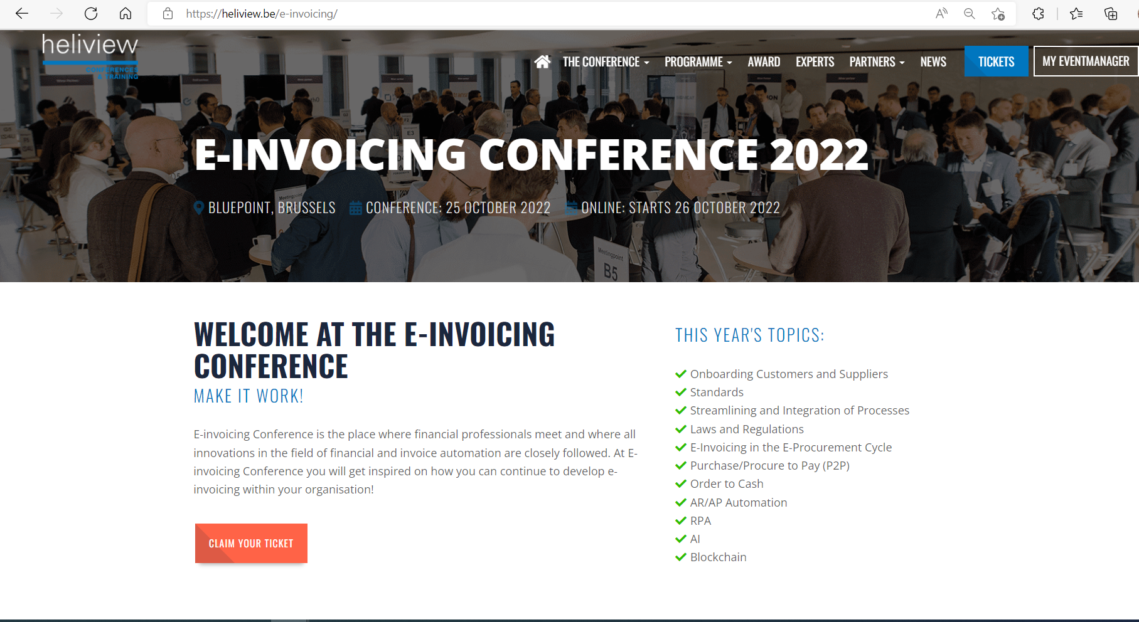
e-Invoicing conference

Slide 11
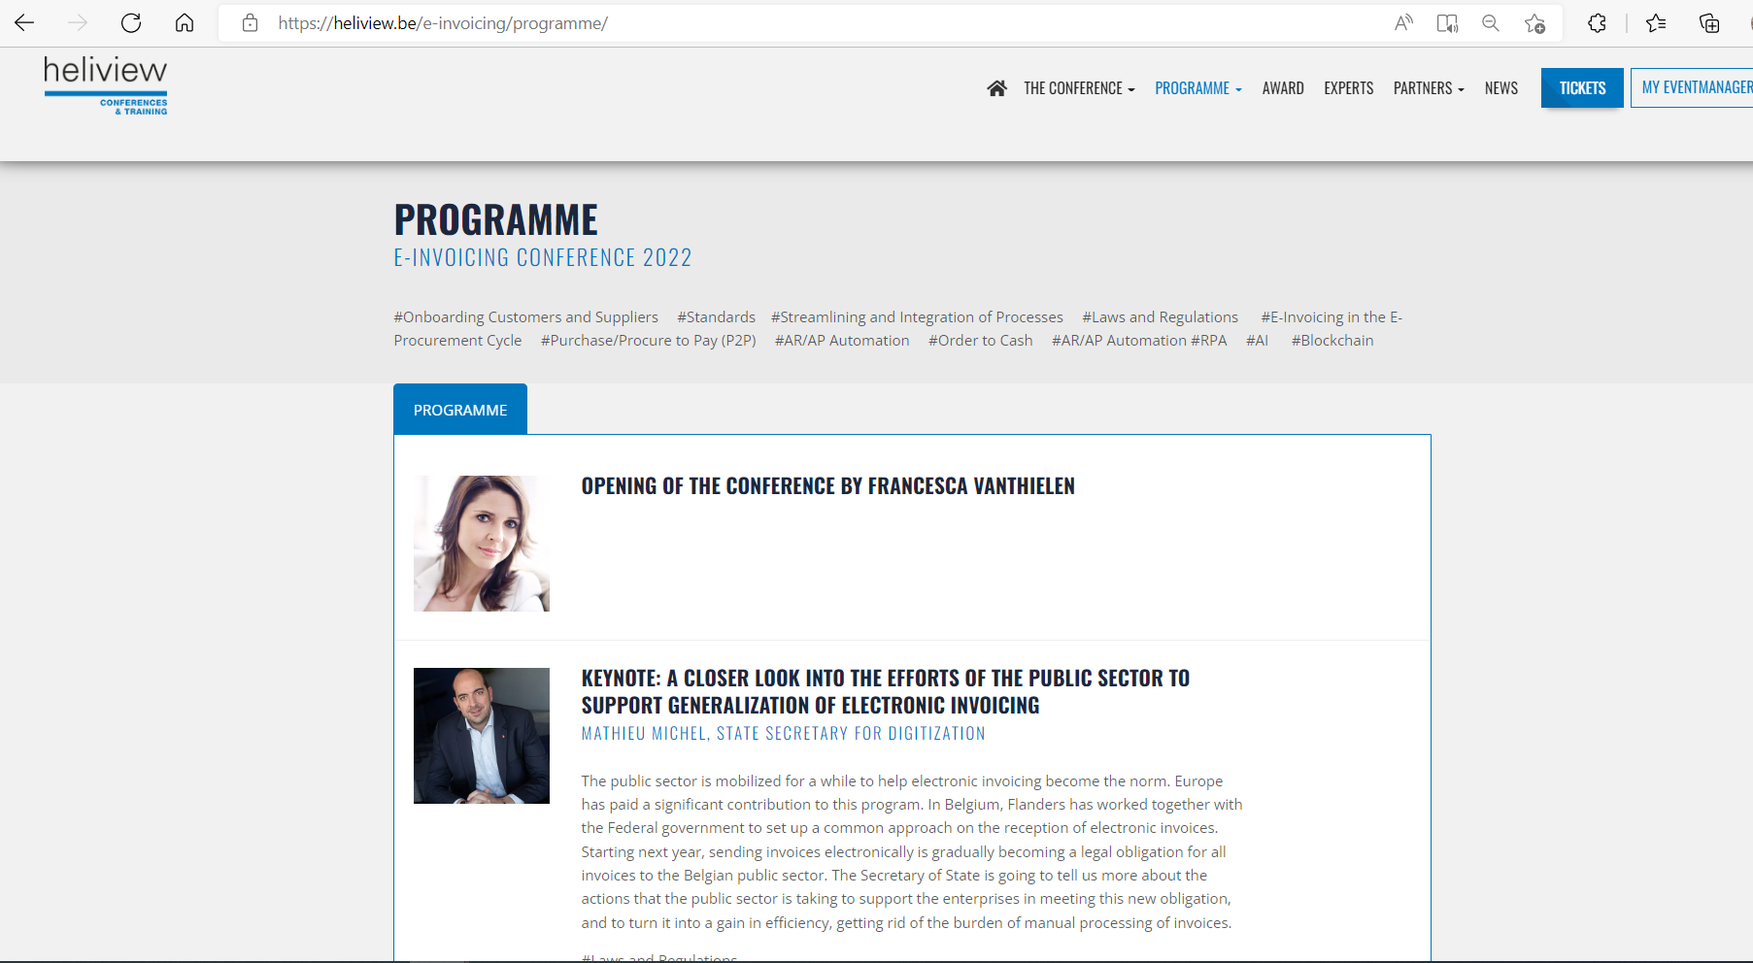
e-Invoicing conference

Slide 12
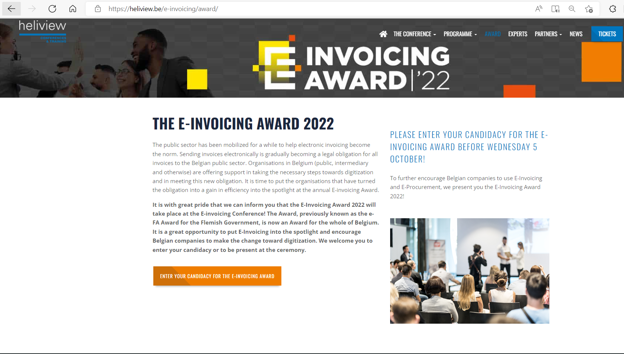
e-Invoicing conference

Slide 13
Agenda
Update from Luxembourg
Update on MLR-IMR
e-Invoicing conference
Service Provider Agreement update
Backlog / AOB / Next forum

Slide 14
Service Provider Agreement update
Belgian Service Providers resigning phase
Status:
All agreements are in, thanks for this.
Some agreements need to be BOSA countersigned and will be provided asap.
Next:
Update on Belgian Peppol Authority page to come with list of Belgian Service Providers.
New version of the agreement will be added soon. No need for Service Providers to sign the latest version as these are just small corrections.

Slide 15
Agenda
Update from Luxembourg
Update on MLR-IMR
e-Invoicing conference
Service Provider Agreement update
Backlog / AOB / Next forum

Slide 16
Backlog
B2B: request to Tax Administration
Your topics?

Slide 17
AOB / Next forum
Next forum: 22.11
Prime contact responsible @ yours?

Slide 18
Thanks for your attendance!

Slide 19
Wrap up

