Slide 1

Belgian Peppol APs Forum
23rd edition
10.5.2022
BOSA-DT

Slide 2
Welcome

Slide 3

Agenda
Agreement Framework Revision
Invoice response: IMR live since 10/03/2022 - Update
Royal Decree – publications of IT solutions (B /G)
Backlog / AOB / Next forum

Slide 4
Agenda
Agreement Framework Revision
Invoice response: IMR live since 10/03/2022 - Update
Royal Decree – publications of IT solutions (B /G)
Backlog / AOB / Next forum

Slide 5
Agreement framework revision
- Recap Last meeting (see minutes) –
Each SP signs new agreement with the PA in which it is legally established.
Annex 5 is replaced by PA specific requirements. It is not subject to separate signing
Belgian PA will adjust practical details accordingly (ex: “APs” becomes “SPs” on 30/6/2022), including the organization of Belgian forum. Such adjustments should be as transparent as possible for service providers.

Slide 6
Agreement framework revision
SP agreement French translation being finalized. We expect to send FR and NL version by end of this month/beginning of next month for re-signing.
A set of PASR is now made available to all SPs and PAs for review cfr. mail OpenPeppol dd. 21/02 and reminder dd. 9/3:
  Published on Confluence: List of PA Specific Requirements - 2022 update - Peppol Agreements Revision - Confluence (atlassian.net)
  Any comments can be submitted by using the comment template. This template must be mailed to openpeppol@peppol.eu
  The review period is 4 weeks and ends on 21 March 2022. All comments submitted in the review period will be processed and made available to the PAs concerned, as well as to the MC.
  For reference, the Internal Regulations can be found here. The Policy on PASR is described in Chapter 7.
  ANY QUESTIONS OR REMARKS?

Slide 7
Agreement framework revision
SP agreement French translation being finalized. We expect to send FR and NL version by end of this month for re-signing.
A set of PASR was made available to all SPs and PAs for review cfr. mail OpenPeppol dd. 21/02 and reminder dd. 9/3:
  This set is still available on Confluence: 2022.02.21 - Review of PA Specific Requirements (Wave 1) - Peppol Agreements Revision - Confluence (atlassian.net) together with the consolidated Comment Log.
  In cooperation with the PAs, OO is now processing the comments. The Belgian PA did provide feedback to OO.
  For reference, the Internal Regulations can be found here. The Policy on PASR is described in Chapter 7.
  ANY QUESTIONS OR REMARKS?

Slide 8
Agenda
Agreement Framework Revision
Invoice response: IMR live since 10/03/2022 - Update
Royal Decree – publications of IT solutions (B /G)
Backlog / AOB / Next forum

Slide 9
Invoice Message Response (IMR)
Live since 10/03/2022
Mercurius Partners can respond to (inbound B2G) invoices with IMR. Response with “old MLR” is still possible until end of migration period (= end of 09/2022)
IMR is applied to the Business Pre Processing Layer : failure to the 4 Business Rules results in IMR, no longer “old” MLR.
Mercurius accepts inbound IMR (new flow) in response to outbound (G2B) Invoicing.

Slide 10
Invoice Message Response (IMR)
Live since 10/03/2022
(Outbound) IMR : Business Response from Mercurius Partners
  To IMR Receivers +2000 times
  To others (non IMR Receivers) via email +8000 times
  Biggest user : VDAB and Stad Gent
IMR : Mercurius responds to Business Pre-Processing Rule Violations
  Inbound : IMR Receivers +5000 and via email +2300

Slide 11
Agenda
Agreement Framework Revision
Invoice response: IMR live since 10/03/2022 - Update
Royal Decree – publications of IT solutions (B /G)
Backlog / AOB / Next forum

Slide 12
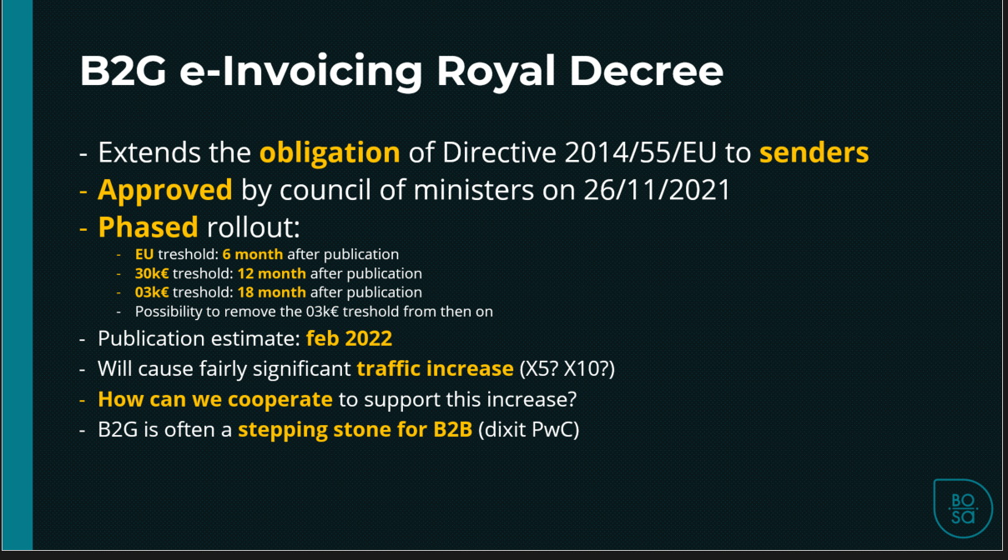
Royal decree: Publication of IT solutions (1/2)
Recap: cf forum 20, 14/12/2021:
Project: BOSA supporting measures
to R.D. rollout
Goal: facilitate suppliers onboarding
Component: IT solutions publication (B / G)
Condition: procedures
Announced: BEG 31/03 + Agoria
Status: Initial draft under public review and comments
Next: Incorporate comments and suggestions, publish procedures, collect requests, publish solutions

Slide 13
Royal decree: Publication of IT solutions (2/2)
- Issues -
How to assess solution coverage (Business Scenarios)
Any other?

Slide 14
Agenda
Agreement Framework Revision
Invoice response: IMR live since 10/03/2022 - Update
Royal Decree – publications of IT solutions (B /G)
Backlog / AOB / Next forum

Slide 15
Backlog / AOB / Next forum
e-Invoicing event
Your topics? (tour de table)
Next forum
Teaming on Peppol communication
First digit of Enterprise number
New tender e-invoicing continuity

Slide 16
First digit of Enterprise number
Question received :
"I received a mail from FOD Economie that in the “near future” the new CBE numbers will start with 1 at the first position instead of 0 as it is now.
Has this any effect on the validations/rules/schematrons/use on the Peppol network or SMP.BELGIUM.BE or …"
Answer :
Relevant information can be found on OpenPeppol eDEC Code Lists :
See Participant Identifier Schemes v8.0 for the relevant rules :
https://docs.peppol.eu/edelivery/codelists/v8.0/Peppol%20Code%20Lists%20-%20Participant%20identifier%20schemes%20v8.0.xlsx

Slide 17
Thanks for your attendance!

Slide 18
Wrap up (1/2)
1. Agreement Framework Revision
(a) translation delayed – BOSA recommends SP to rely on English original for their internal preparation to re-signing, as the translation will match exactly. SPs haven’t raised issue with this approach.
(b) PA SR comments received and processedµ
2. Invoice response: status update
(a) Billit remark about wording of emails transposing IMR when receiver has not suitable RC’s: BOSA confirms it refers to IMR, not MLR – however some Gov entities are still sending MLRs (not yet migrated to IMR), which may get turned into emails too when the receiver has no MLR RC.
(b) BOSA will investigate the feasibility of tuning such email body.
(c) Billit will check if his remark matches this scenario.

Slide 19
Wrap up (2/2)
3. Royal Decree – publications of IT solutions (B /G)
(a) Anyone who can help, is welcome to participate. The initiative has been duly communicated and broadcasted.
(b) The main priority is to help the senders. The vast majority of senders who will need help in the short/medium term, need tools to send invoices. Therefore the main focus of the list that Government must publish, is on such tools.
(c) Link to the procedures :
- NL version
- FR version
(d) Translation is not provided by BOSA. SPs operating in Belgium are supposed to be OK with FR and/or NL.
4. Backlog / AOB / Next forum
(a) Upcoming change in CBE ID (0208) first digit : Billit to verify that schematron implementation matches the requirement and if not, issue request on https://openpeppol.atlassian.net/servicedesk/customer/portal/1
(b) Your topics: synch issue SMP-Peppol Directory:
- Known in the SP community, recommendation is to foresee retry mechanisms to overcome possible timeouts in the processing e.g. at the level of the push to Peppol Directory
- Issue also reported today by UP to BOSA, is on its way to BOSA’s subcontractor
(c) Next Forum on June 21st– please send us your topics. Thanks in advance for your constructive participation.

