Slide 1
Belgian Peppol APs Forum
20th edition
14.12.2021
BOSA-DT

Slide 2
Welcome

Slide 3
Agenda
Agreement Framework Revision
B2G e-Invoicing Royal Decree
Hermes
Invoice response: old BIS (2.0) MLR phase out, IMR phase in
Backlog / AOB / Next forum

Slide 4
Agenda
Agreement Framework Revision
B2G e-Invoicing Royal Decree
Hermes
Invoice response: old BIS (2.0) MLR phase out, IMR phase in
Backlog / AOB / Next forum

Slide 5
Agreement framework revision
- Recap Last meeting (see minutes) –
After intensive review and consultation, Platinum version proposed as revision of the agreements framework
Currently submitted to the voting of the PAs
Transition from current to new framework
Termination notice to be sent 01/01/2022
New framework effective 1/7/2022

Slide 6
Agreement framework revision
- Update -
28/10/2021:
platinum version of the agreements framework was approved by voting of the PAs
16/11/2021:
IR (on use of the Peppol Network) platinum version was approved by the MC

Slide 7
Agreement framework revision
- Update -
BOSA is currently in the process of
signing new PA agreement with open Peppol
translating the SP agreement (legal obligation)
issuing termination notices to all AP Providers under old regime
Proposing revised agreement to all Service Providers with legal residence in Belgium. Incl Tradeshift (signed current TIA with OpenPeppol)
Redirecting other AP Providers to OpenPeppol (Esker, OpenText GXS)
Above steps due 24/12/2021 → meet fixed regime switchover date (1/7/2021)

Slide 8
Agreement framework revision
Update –
Documentation centrally available:
New Peppol Agreements and accompanying documents - Peppol Agreements Revision
Annex 5 between AP and BOSA are terminated together with Parent TIA termination.
Old-regime-Annex 5: replaced by PA Specific Requirements (PASR).
Integral part of agreements framework.
BOSA-PASRs: (1°) use of 0208 mandatory; (2°) use of smp.Belgium.be still allowed

Slide 9
Agreement framework revision
Request –
Please brief your formal contacts as Per Annex 1 (4.5)
if not yet done

Slide 10
Agreement framework revision
AdValvas Europe | Michel Gilis
Arco Information N.V. | Robrecht Mosselmans
B2Bgrid | Joris Ballet
Billit | Michael Demeersseman
Brain2 | Mark Van Hamme
Breex Easybox | Ellen Poppe
CodaBox N.V. | Jean de Crane
Connect Solutions bvba | Eddy Mommen
Descartes Systems (Belgium) NV | Rob Vermeulen
Desk Drive | Antoine Bruckers
Digiteal SA | Cedric Neve
Dynatos NV | Patrick Slachmuylders
Generix Group Benelux | Willem Seru
ILGE Sybscription Management BVBA | Balak Deniz
Inaras NV | Wim Maerevoet
Ixor bvba | Roel Verbeeck
Nestoya | Jan Mrowca
Netropolix Software NV | Jan Vangorp
Odoo SA | Benjamin Stiénon
OptiPost NV | Sven Dauwe
Soluz.io | Brecht Verhaegen
UnifiedPost Group | Frie Vanparijs
Tradeshift Belgium
Esker S.A. | Thibault Samson
OpenText (GXS) | Gail Gennings

Slide 11
Agreement framework revision
Questions ? –

Slide 12
Agenda
Agreement Framework Revision
B2G e-Invoicing Royal Decree
Hermes
Invoice response: old BIS (2.0) MLR phase out, IMR phase in
Backlog / AOB / Next forum

Slide 13
B2G e-Invoicing Royal Decree
Extends the obligation of Directive 2014/55/EU to senders
Approved by council of ministers on 26/11/2021
Phased rollout:
EU treshold: 6 month after publication
30k€ treshold: 12 month after publication
03k€ treshold: 18 month after publication
Possibility to remove the 03k€ treshold from then on
Publication estimate: feb 2022
Will cause fairly significant traffic increase (X5? X10?)
How can we cooperate to support this increase?
B2G is often a stepping stone for B2B (dixit PwC)

Slide 14
Agenda
Agreement Framework Revision
B2G e-Invoicing Royal Decree
Hermes
Invoice response: old BIS (2.0) MLR phase out, IMR phase in
Backlog / AOB / Next forum

Slide 15
Hermes
Since last AP Forum:
Unregistered traffic is monitored and shared where appropriate. Please do come back to us with your questions.
Most of you took the opportunity to sign the Hermes Integrators agreement. Some amended their systems

Slide 16
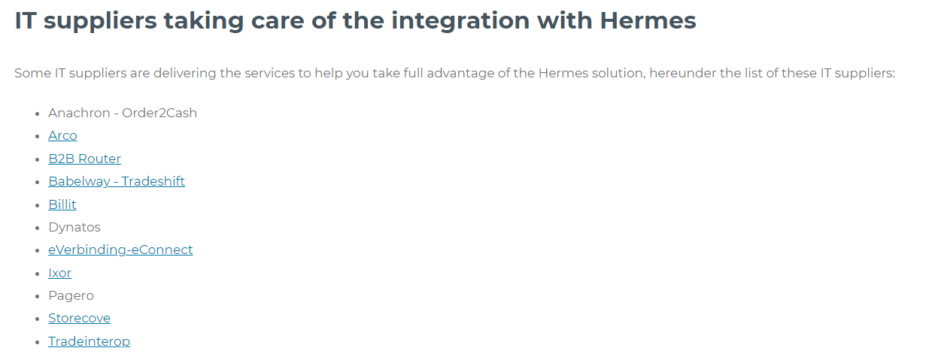
Hermes
Integrators are now referenced on einvoice.belgium.be
Hermes is monitored, integrators are monthly informed should something be missing

Slide 17
Agenda
Agreement Framework Revision
B2G e-Invoicing Royal Decree
Hermes
Invoice response: old BIS (2.0) MLR phase out, IMR phase in
Backlog / AOB / Next forum

Slide 18
Invoice message response (IMR): old BIS (2.0) MLR phase out, IMR phase in
PA invites APs to trigger the old bis (2.0) MLR phase out together with their invoice senders (inform, sensibilize, …)
Progress IMR testing
Pilots : BOSA, De Watergroep, VDAB, Orafin
Access Points : Exact and eConnect

Slide 19
Testplan IMR : overview
Phase | Name | What | When
1 | BOSA | Internal tests | Ongoing
2 | Roundtrip pilots | Pilots execute tests themselves - between each other | 1st phase : start 13 Dec 2021 2nd phase : start 20 Dec 2021
3 | Between pilots
4 | With Exact and eConnect | clients to send invoices to pilots and receive/process invoice message responses (IMR) | start 15 Jan 2022

Slide 20
Agenda
Agreement Framework Revision
B2G e-Invoicing Royal Decree
Hermes
Invoice response: old BIS (2.0) MLR phase out, IMR phase in
Backlog / AOB / Next forum

Slide 21
Backlog / AOB / Next forum
Next forum on January 25th
BIS schematrons update fall 2021 – warning on 0208 BIS schematrons update spring 2022 – error on 0208
E-Invoicing Event 2022 confirmed Oct. 25th

Slide 22
Thanks for your attendance!

Slide 23
Wrap up
Agenda/slideware/streaming | Wrap up
Agenda: Agreement Framework Revision B2G e-Invoicing Royal Decree Hermes Invoice response: old BIS (2.0) MLR phase out, IMR phase in Backlog / AOB / Next forum Slides: <SLIDES> | 1. Agreement Framework Revision SPs are invited to brief their prime contact (TIA annex 1, part 4.5) If need to change prime contact please issue an Annex 1 update and send to PA. 2. B2G e-Invoicing Royal Decree SPs are invited to work together with BOSA to set-up supporting measures Clarification : granularity of invoice details (line item level): the applicable law does not give a clear cut on this. It is up to the sender to appropriately describe the goods and services 3. Hermes Publication of list of Hermes integrators on einvoice.Belgium.be: integrators with missing partners fiche: feel free to submit your request to become partner

