Slide 1

Belgian APs Forum
11th edition
13.10.2020
BOSA-DT

Slide 2
Agenda
Update progress on CBE schemeID migration
Hermes SMP Migration Token Collection Interface test debrief
Decommissioning old BIS billing (2.0)
Call for success stories (SMB)
Peppol Agreements Framework
Backlog / Next forum
AOB

Slide 3
Agenda
Update progress on CBE schemeID migration
Hermes SMP Migration Token Collection Interface test debrief
Decommissioning old BIS billing (2.0)
Call for success stories (SMB)
Peppol Agreements Framework
Backlog / Next forum
AOB

Slide 4


Update progress on CBE schemeID migration
Monitoring of progress ==> monthly snapshots all the way through 01-05-2021
First results – First Snapshot end of September 2020
12 AP's filled in the questionnaire!
10 AP's did not fill in the questionnaire!

Slide 5
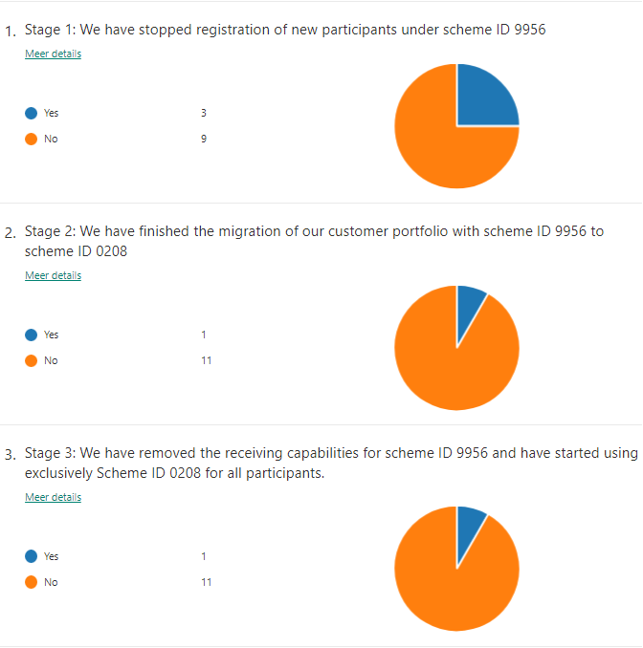
Update progress on CBE schemeID migration
First Snapshot end of September 2020

Slide 6
Update progress on CBE schemeID migration
II. Harmonize adoption of new schemeID (0208): Reported concern:
  AP not yet supporting reception/registration of 0208-based documents, will keep registering new clients with 9956-based identifiers
  It means that the client is NOT migrated (as expected in hermes design) (for a while)
  Such clients risk to receive converted e-invoices through hermes based on 0208 registration

Slide 7
Hermes migration principle – theory
SML
Company x subscribed (Hermes)
Company x subscribed (CBX)
HERMES SMP
Company x subscribed
Belgium SMP
Company x not subscribed
Company x subscribed (CBX)

Slide 8
Hermes (0208) & CodaBox (9956) registration – Current implementation
SML
0208:x subscribed (Hermes)
9956:x subscribed (CBX)
HERMES SMP
0208:x subscribed
Belgium SMP
9956:x not subscribed
9956:x subscribed (CBX)

Slide 9
Hermes (0208) & CodaBox (9956) registration – Future after 0208 implementation
SML
0208:x subscribed (Hermes)
9956:x subscribed (CBX)
0208:x subscribed (CBX)
HERMES SMP
0208:x subscribed
0208:x not subscribed
Belgium SMP
9956:x not subscribed
9956:x subscribed (CBX)
0208:x subscribed (CBX)
Implementation of 0208 beginning of 2021

Slide 10
Proposal with cleanup
SML
0208:x subscribed (Hermes)
9956:x subscribed (CBX)
HERMES SMP
0208:x subscribed
Company x subscribed
Belgium SMP
9956:x not subscribed
9956:x subscribed (CBX)
Cleanup of Hermes based on registrations of 0208 and 9956 for Belgian companies (possible mismatch for x hours/days)

Slide 11
Discussion

Slide 12
Agenda
Update progress on CBE schemeID migration
Hermes SMP Migration Token Collection Interface test debrief
Decommissioning old BIS billing (2.0)
Call for success stories (SMB)
Peppol Agreements Framework
Backlog / Next forum
AOB

Slide 13
Hermes SMP Migration Token Collection Interface test debrief hsmp-mtci
Early Bird testing finished: feedback given.
Start of next phase: All AP’s to test as of 5.10,
Feedbacks ongoing
End of testing phase on 16.10 (that’s this Friday)
Call to action:
Don’t forget to ask for your dataset!
Let us know when you start…
Enjoy the testing
And of course give us your feedback

Slide 14
Agenda
Update progress on CBE schemeID migration
Hermes SMP Migration Token Collection Interface test debrief
Decommissioning old BIS billing (2.0)
Call for success stories (SMB)
Peppol Agreements Framework
Backlog / Next forum
AOB

Slide 15
Decommissioning old BIS billing (2.0) – recap previous forum
Be GOV Findings & expectations
  Usage of old BIS Billing decreases
  But was still 45% of invoices received by BE GOV in August
  BE GOV schedule for removal of old BIS Billing Receiving Capabilities:
    In TEST (through smk): 1.11.2020
    In PROD (through sml): 31.12.2020
  Please inform your senders
Agreed
  BOSA sends communication for senders to sending APS
  Sending APS relay and back the communication
  VO also communicates to senders

Slide 16
Decommissioning old BIS billing (2.0) – Update
Results observed on mrcs
Discussion
MONTH | BIS2 ONLY sndrs | TOTAL sndrs | RATIO | BIS2 invoices RATIO
6 | 626 | 1522 | 41% | 58%
7 | 530 | 1465 | 36% | 54%
8 | 507 | 1395 | 36% | 49%
9 | 564 | 1696 | 33% | 46%

Slide 17
Agenda
Update progress on CBE schemeID migration
Hermes SMP Migration Token Collection Interface test debrief
Decommissioning old BIS billing (2.0)
Call for success stories (SMB)
Peppol Agreements Framework
Backlog / Next forum
AOB

Slide 18
Agenda
Update progress on CBE schemeID migration
Hermes SMP Migration Token Collection Interface test debrief
Decommissioning old BIS billing (2.0)
Call for success stories (SMB)
Peppol Agreements Framework
Backlog / Next forum
AOB

Slide 19
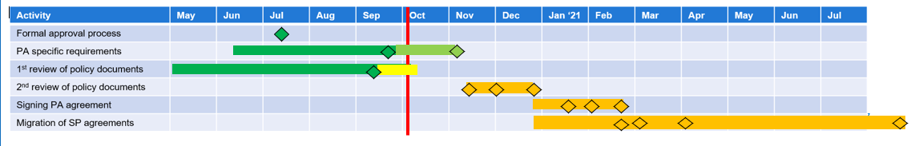
Peppol Agreements Framework
July 13 PA voting on new agreement documents closed (T1)
PA Specific Requirements
Sept 20 Compliance review of PA specific requirements completed
Dec 18 All PA Specific Requirements approved by MC
Policy documents
Sep 11 Deadline for first review comments on policy documents
Nov 10 Initiate second review (2 weeks) of policy documents
Nov 30 Deadline for 2nd review comments
Dec 18 Supporting policy documents approved by MC
Signing PA agreement
Jan 20 Most PA’s have signed new agreement (T2)
Feb 1 Common effective date for PA Agreement
Feb 20 All PA’s have signed new agreement
Signing SP Agreement
Feb 20 Critical mass of SP’s has accepted/signed new SP Agreement
Mar 1 Termination notice sent to the remaining SP’s (T3)
Apr 1 Common effective date for SP Agreements
Sep 1 All old agreements terminated (T4)
About 1000 comments
PA Task Force

Slide 20
Peppol Agreements Framework
The purpose of the Interoperability Framework Change Management Taskforce is to:
Separate the scope of the current policy into those documents which must be subject to strict revision controls (the Citadel), and those that should be governed by less restrictive procedures.
Suggest revisions to the Change Management Model in order to ensure that each class of elements is governed in ways that improve the policy documents to provide sufficient clarity and certainty to the Parties to the Agreement, while also retaining the necessary operational agility
Draft for discussion and approval

Slide 21
Agenda
Update progress on CBE schemeID migration
Hermes SMP Migration Token Collection Interface test debrief
Decommissioning old BIS billing (2.0)
Call for success stories (SMB)
Peppol Agreements Framework
Backlog / Next forum
AOB

Slide 22
Agenda
Update progress on CBE schemeID migration
Hermes SMP Migration Token Collection Interface test debrief
Decommissioning old BIS billing (2.0)
Call for success stories (SMB)
Peppol Agreements Framework
Backlog / Next forum
AOB

Slide 23
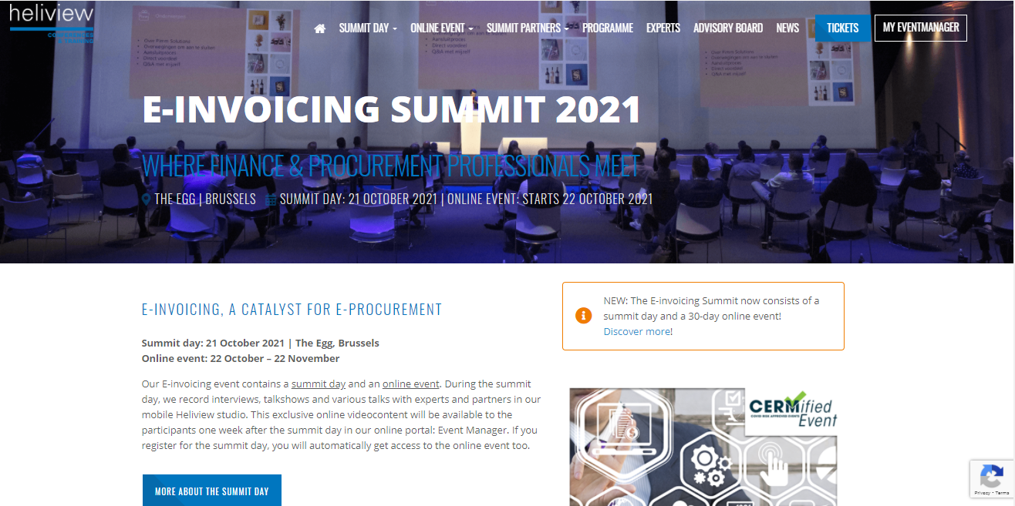
AOB
https://heliview.be/e-invoicing/

Slide 24
Thanks for your attendance!

