Slide 1
Belgian APs Forum
9th edition
14.07.2020
BOSA-DT

Slide 2
Agenda
9956>0208 migration – the way forward
Agreements migration – update
eInvoicing Summit
Backlog / Next forum
AOB

Slide 3
Agenda
9956>0208 migration – the way forward
Agreements migration – update
eInvoicing Summit
Backlog / Next forum
AOB

Slide 4
Migration 9956>0208
Timeline
Milestones:
A
Migration phase
B
(10-month)
ONLY 9956
COHABITATION
ONLY 0208
Schedule:
01-07-2020
01-05-2021
What:
Summer 20 release:
0208 INTRODUCTION
Spring 21 release:
9956 DEPRECATION

Slide 5
Migration 9956>0208
Timeline
Milestones:
A
Migration phase
B
(10-month)
ONLY 9956
COHABITATION
ONLY 0208
Schedule:
01-07-2020
01-05-2021
What:
Summer 20 release:
0208 INTRODUCTION
Spring 21 release:
9956 DEPRECATION
Scenario:
minimal: AP’s solely manage the migration within the above boundaries
level-1 discipline: Stop 9956-based registrations at X
level-2 discipline: transpose all 9956-based registrations at Y
level-3 discipline : remove all 9956-based registrations at Z
DETERMINE X, Y, Z - smp.belgium.be will meet the selected discipline level / timing

Slide 6
Agenda
9956>0208 migration – the way forward
Agreements migration – update
eInvoicing Summit
Backlog / Next forum
AOB

Slide 7
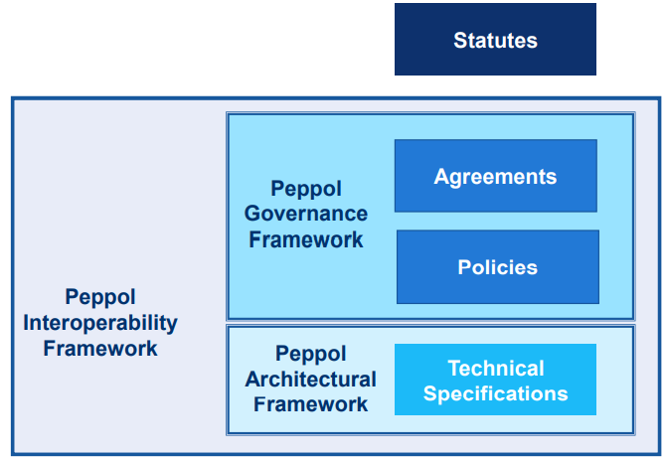
What do we achieve with new agreements
Stability
Transparency
Uniformity
Consistency
Adaptability
Scalability
Key to the future
Notes:
Together with policies, new agreements considerably improve stability, transparency, uniformity, consistency and adaptability of the Peppol Interoperablity framework
Stability: split legal from other concerns (practical and technical) and improve both. Agreement focus on legal. Thanks to much broader contribution than original framework
Transparency: the new agreements and policies go much further in the description of the governance regime, yet it stays pragmatic
Uniformity: applies to all the same way. No difference beween domains (→ no reason to sign elsewhere)
Consistency: policies-driven approach fosters the consistency of the framework as a whole.
Adaptability: evolution can happen faster and in a more focused way
Scalability: as we grow in use geographically, in volume and in service areas, we will encounter new challenges. The new governance framework is designed to better address this (eg annexes for national use cases and incubation)
Last but not least the communities structure has improved and expanded to domain and stakeholders communities with specific, complementary and consistent roles and responibilities. Their operations are described and organized in the policies

Slide 8
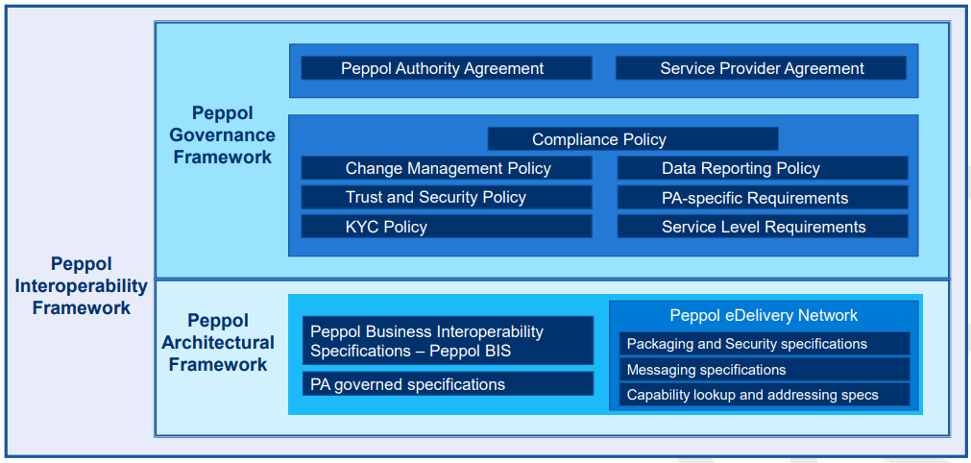
What do we achieve with new agreements
Stability
Transparency
Uniformity
Consistency
Adaptability
Scalability
Key to the future
Notes:
Together with policies, new agreements considerably improve stability, transparency, uniformity, consistency and adaptability of the Peppol Interoperablity framework
Stability: split legal from other concerns (practical and technical) and improve both. Agreement focus on legal. Thanks to much broader contribution than original framework
Transparency: the new agreements and policies go much further in the description of the governance regime, yet it stays pragmatic
Uniformity: applies to all the same way. No difference beween domains (→ no reason to sign elsewhere)
Consistency: policies-driven approach fosters the consistency of the framework as a whole.
Adaptability: evolution can happen faster and in a more focused way
Scalability: as we grow in use geographically, in volume and in service areas, we will encounter new challenges. The new governance framework is designed to better address this (eg annexes for national use cases and incubation

Slide 9
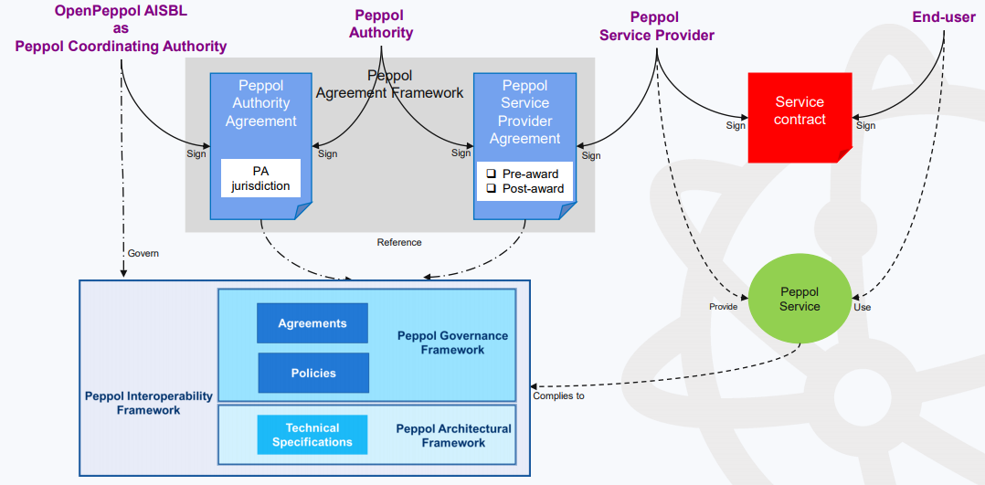
Contracts layer

Slide 10
Revised Timeline
30/06/2020
New agreements framework (A.F.) ready
(Approval request sent)
July 8
..
Aug 14
policies under review
13/07/2020
Agreements framework (A.F.) approved
30/08/2020
Most PAs renewed
policies approved by MC
Sept 15
30/11/2020
Most SPs renewed → send old TIA termination notice
All approved policies take effect when new agreemeents take effect
01/01/2021
New agreement enters into force (*)
6 month
31/05/2021
Old TIA terminated
BOSA to renew before Sept 15
(*) tentative possibility under consideration
dates in gray might change slightly
Notes:
Agreements framework (A.F.) approved by 60% of PAs

Slide 11
Agenda
9956>0208 migration – the way forward
Agreements migration – update
eInvoicing Summit
Backlog / Next forum
AOB

Slide 12
E-Invoicing Summit 2020
https://heliview.be/e-invoicing
The digitalisation of invoices is a real catalyst for digital transformation of the financial and procurement department.

Slide 13
E-Invoicing Summit 2020

Slide 14
Agenda
9956>0208 migration – the way forward
Agreements migration – update
eInvoicing Summit
Backlog / Next forum
AOB

Slide 15
BackLog / next forum
BackLog
Hsmp Migration token collection i/f - testing
BIS migration, final steps
Onboarding of contracting authorities
Be SPs Forum online
Next forum schedule + agenda

Slide 16
AOB

Slide 17
Thanks for your attendance!

