Slide 1
Belgian AccessPoints Forum
Fourth edition
15-05-2018
Serge Libert / Dirk Willekens
BOSA-DT

Slide 2
Agenda
Progression of PEPPOL rollout in Belgium
OpenPEPPOL communication tools
Official webpage of the Belgian PA
PEPPOL certificats migration Q3/2018
Implementation of the European Norm – PEPPOL side
Upcoming CEF telecom call on e-invoicing
Statistics on sender data
Practical organisation of the AP forum
AOB

Slide 3
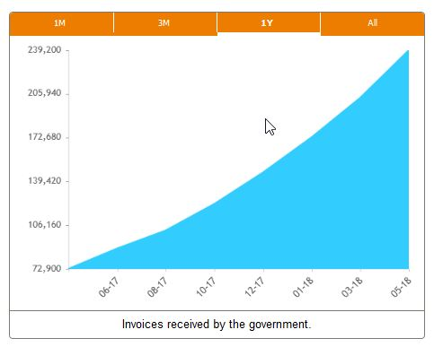
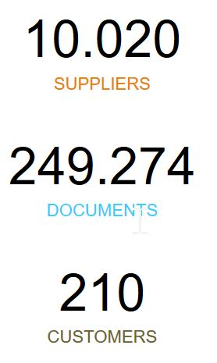
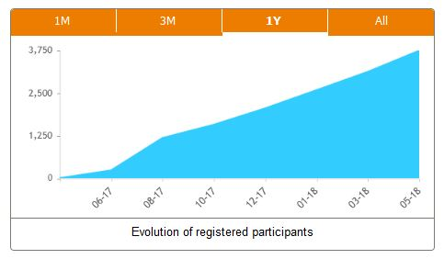
1. Progression of the PEPPOL rollout in Belgium
B2G
B2B
#invoices | 1/5/2016 – 30/4/2017 | 1/5/2017 – 30/4/2018
PEPPOL | 10460 | 75648
Portal | 7965 | 49148
Legacy | 49741 | 26064
PEPPOL gains traction!

Slide 4
2. openPEPPOL communication tools
PEPPOL.eu:
100% public
Legacy website
Openpeppol.atlassian.net:
Collaborative space – mainly restricted access
Some public pages (see next agenda items)
(probably) published on peppol.eu
Any comments?

Slide 5
3. Belgian PEPPOL Authority site
openpeppol.atlassian.net/wiki/spaces/belgium
Instructions for AP
Visibility for AP
Meeting minutes
Hot issues affecting the network operations
Will be moved to efactuur.belgium.be
Suggestions?

Slide 6
4. PEPPOL certificates migration
Where:
openpeppol.atlassian.net/wiki/spaces/OPMA[...]
What:
Old certificates will be revoked 30 November 2018
all PEPPOL AP and SMP will be required to implement the capability to support both the new and the old root certificates before 3 September 2018
Any comments?

Slide 7
5. European Norm – PEPPOL BIS v3
Directive 2014/55/EU
EN 16931 / IPR
18/4/2019
Belgian law
PEPPOL BIS v3
Feedback?

Slide 8
6. New CEF Telecom call – eInvoicing (CEF-TC-2018-2)
- 5 million grants available for improving your platform interoperability
- more info: Connecting Europe Facility (CEF) - eInvoicing
Feedback?

Slide 9
7. PEPPOL Statistics – discussion (ii)
Recap last forum: senders stats will motivate receivers
PEPPOL reporting workgroup: specifies requirements (eoy)
Setup pilot for collecting sender data in BE
Sender data:
AP
SenderID
Doc. Type
Start & end date period
Volume (# invoices)
…
How organize data collection?

Slide 10
8. Practical organisation of the AP forum
One AP = one contact
Default Contact = Annex 1 , section 4.5 (formal notices)
Each AP can nominate another contact for the AP Forum invitation.
Remarks?

Slide 11
9. AOB
Server Name Indication (SNI) – discussion
Invoice Response
…

Slide 12
Thanks for your attendance!

